Slide 1

A BRIEF
STATISTICAL ANALYSIS ON FIFA
2023 RATING SYSTEM
Presented by
RAJDEEP NANDI
B.Sc. (SEM - vi)
Department of statistics
Siksha Bhavana
VISVA BHARATI UNIVERSITY

Slide 2
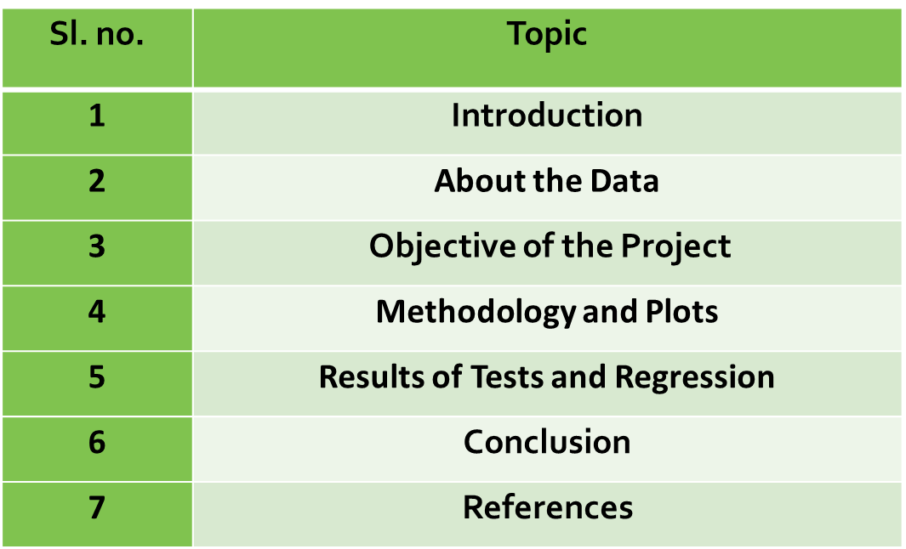

Contents

Slide 3



INTRODUCTION:
(ABOUT FIFA)
FIFA is the governing body of association football, beach soccer, and futsal. It was founded in 1904 to oversee international competition and currently has 211 national associations as members. Its headquarters are located in Zurich, Switzerland, and its member associations are divided into six regional confederations: CAF, AFC, UEFA, CONCACAF, OFC, and CONMEBOL. Football is not only a sport but a culture of patriotism, love, and celebration that unites fans from all over the world.

Slide 4
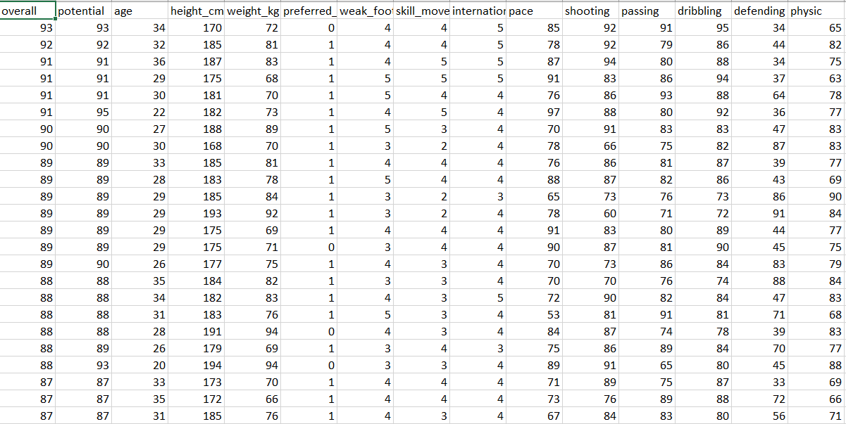
ABOUT THE DATASET:
IT IS THE DATA OF FIFA 2023.WE HAVE VARIOUS RATING OF DIFFERENT PLAYERS.IT HAS OVERALL RATING , POTENTIAL RATING,PACE RATING ,SHOOTING RATING ,PASSING RATING,DRIBBLING RATING ,DEFENDING RATING,PHYSIC RATING,WEAK FOOT RATING,SKILL MOVES RATING AND INTERNATIONAL RATING.THE DATASET HAS SOME CATEGORICAL DATA AND SOME CONTINUOUS DATA.HERE WEAK FOOT RATING,SKILL MOVES RATING AND INTERNATIONAL RATING ARE THE CATEGORICAL DATA AND THE OTHER RATINGS ARE CONTINUOUS DATA . HERE IN MY DATASET THERE HAS A COLUMN OF PREFERRED FOOT WHERE 0 DENOTES THE PREFERRED FOOT AS LEFT FOOT AND 1 DENOTES THE PREFERRED FOOTAS RIGHT FOOT.

Slide 5

TYPES OF RATING AND RANGE OF THAT RATINGS:
OVERALL RATING:- 0-100
POTENTIAL RATING:- 0-99
PACE RATING:-0-100
SHOOTING RATING:- 0-100
DRIBBLING RATING:- 0-100
PASSING RATING:- 0-100
DEFENDING RATING:- 0-100
PHYSIC RATING:- 0-100
WEAK FOOT RATING:-1,2,3,4,5
SKILL MOVES RATING:- 1,2,3,4,5
INTERNATIONAL RATING:- 1,2,3,4,5
PREFERRED FOOT :- 0,1

Slide 6
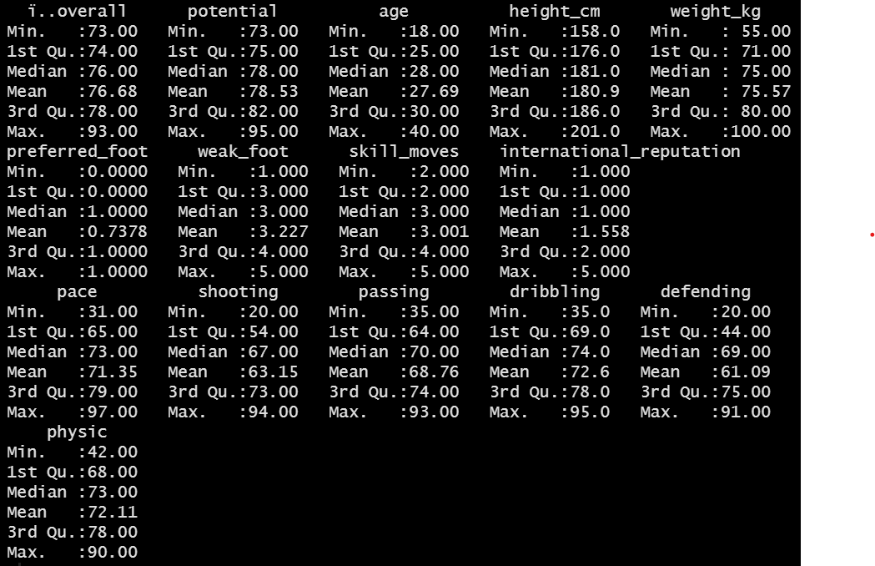
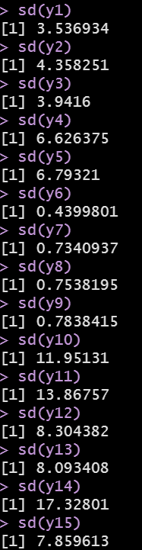
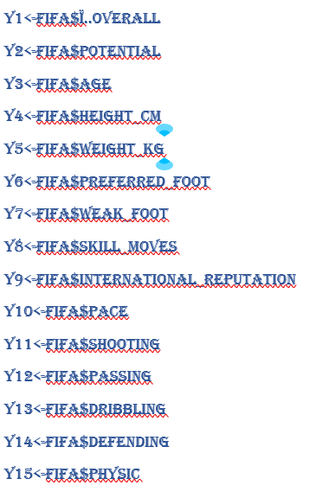
SUMMARY OF THE DATASET:-

Slide 7

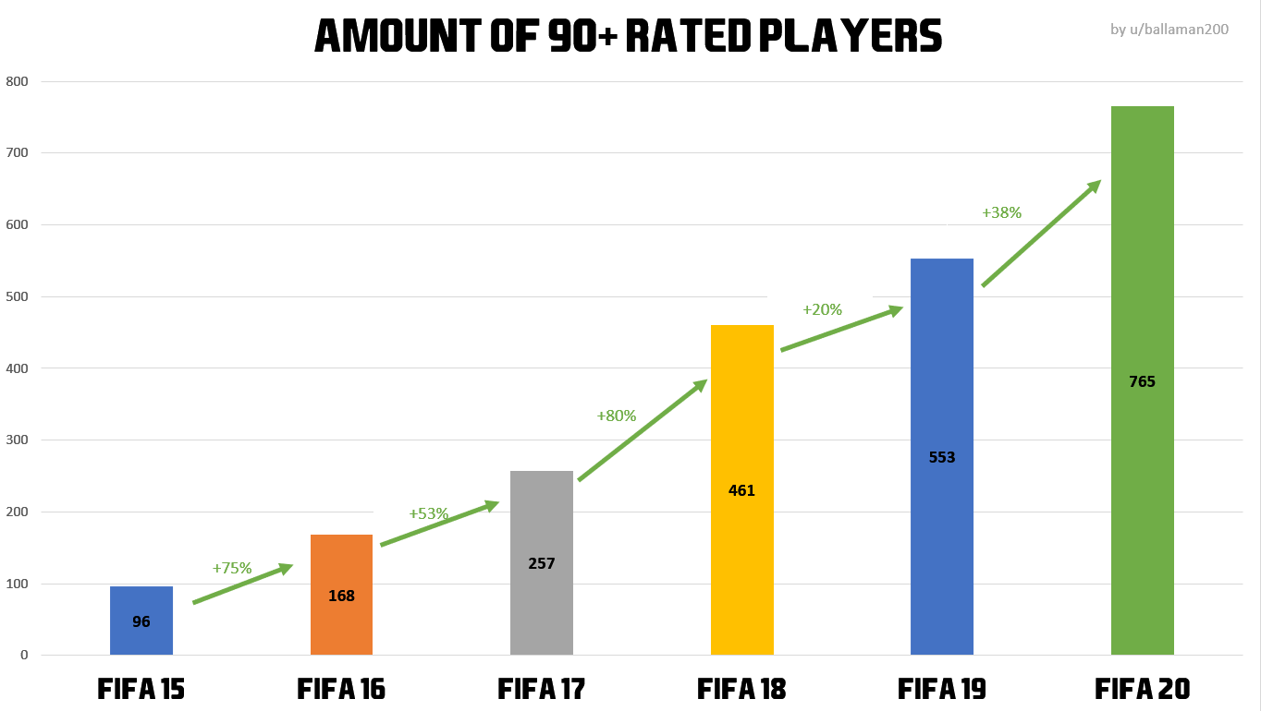
Objective of the project :
With the given DATASET , our main objective is to find any possible Association between the RATINGS and the Relationship between various ratings and to establish the conclusion based on the results on a few statistical analysis such as MULTIVARIATE REGRESSION ANALYSIS,ANOVA,GENERALIZED LINEAR MODEL; creating models and few non-parametric tests on the various data set, whether the models are appropriate or not (using assumptions).The purpose of this analysis is to imply proper understanding of data handling of Football and inference properly about the characteristics .

Slide 8
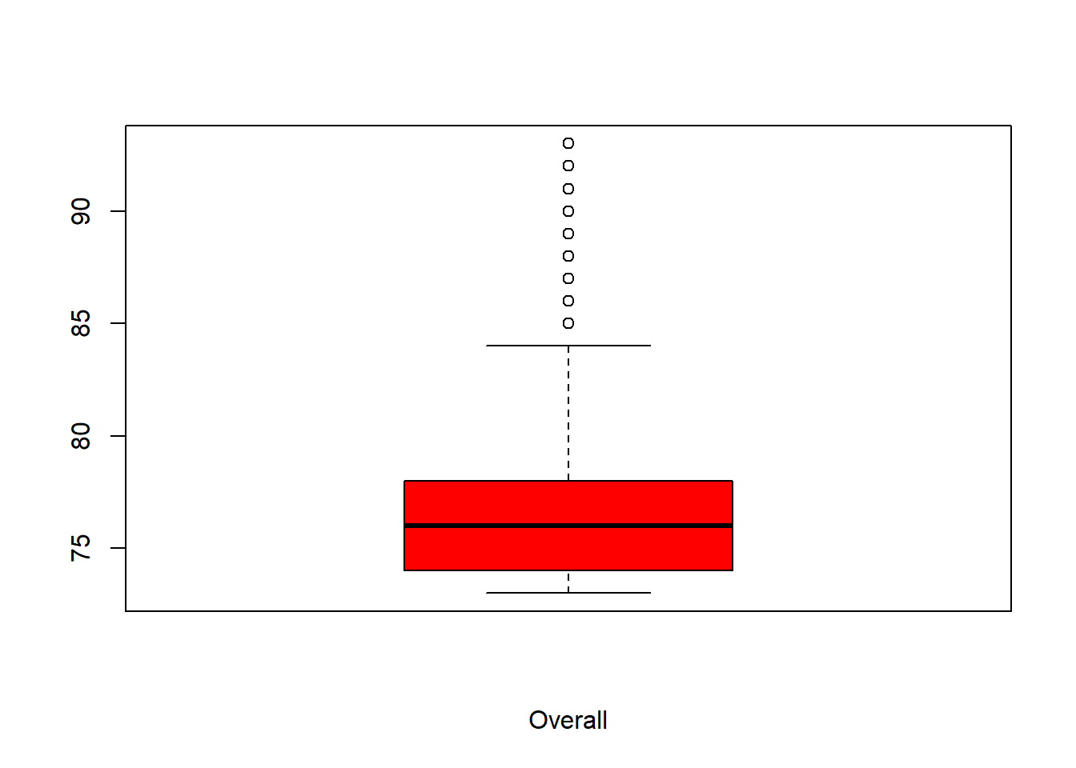
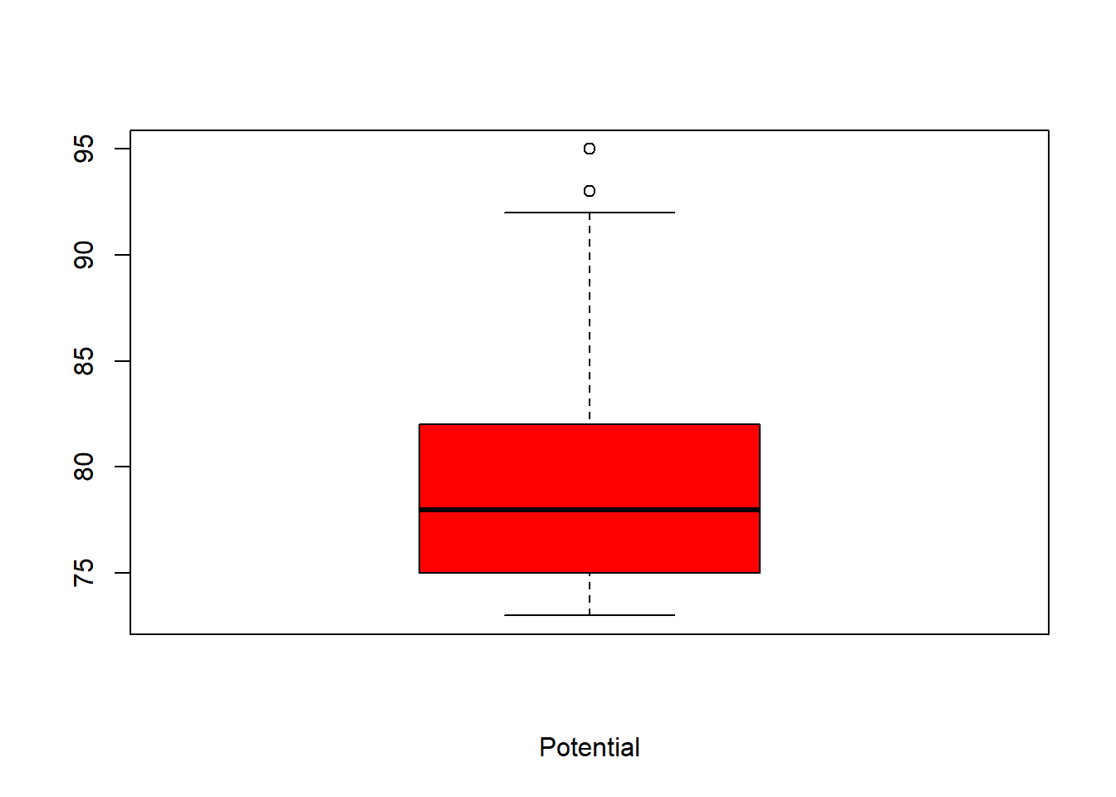
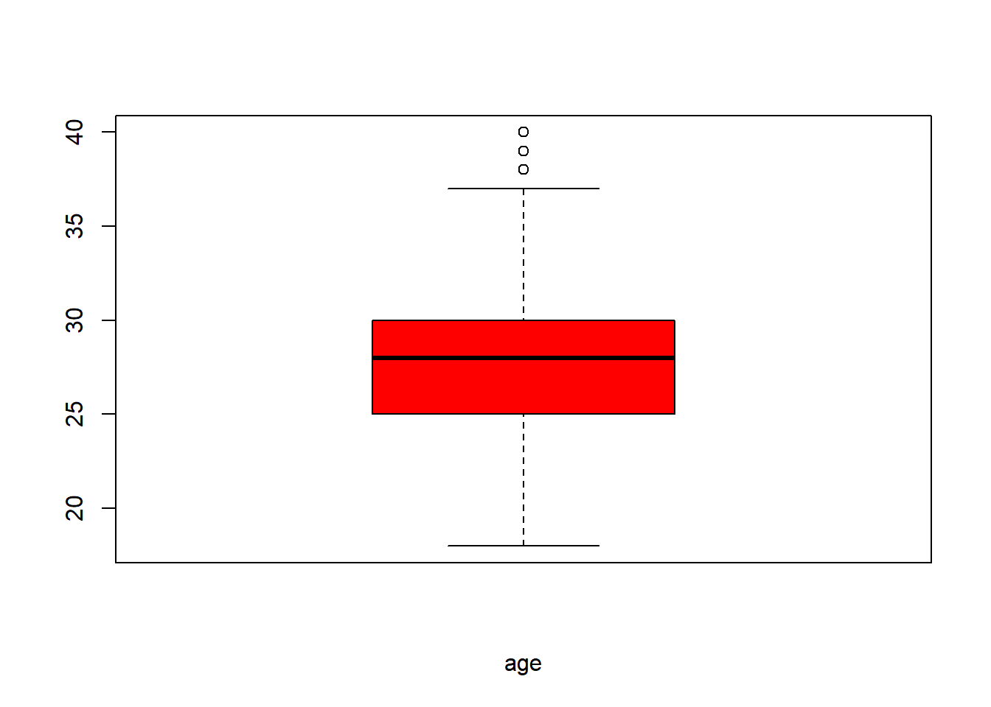
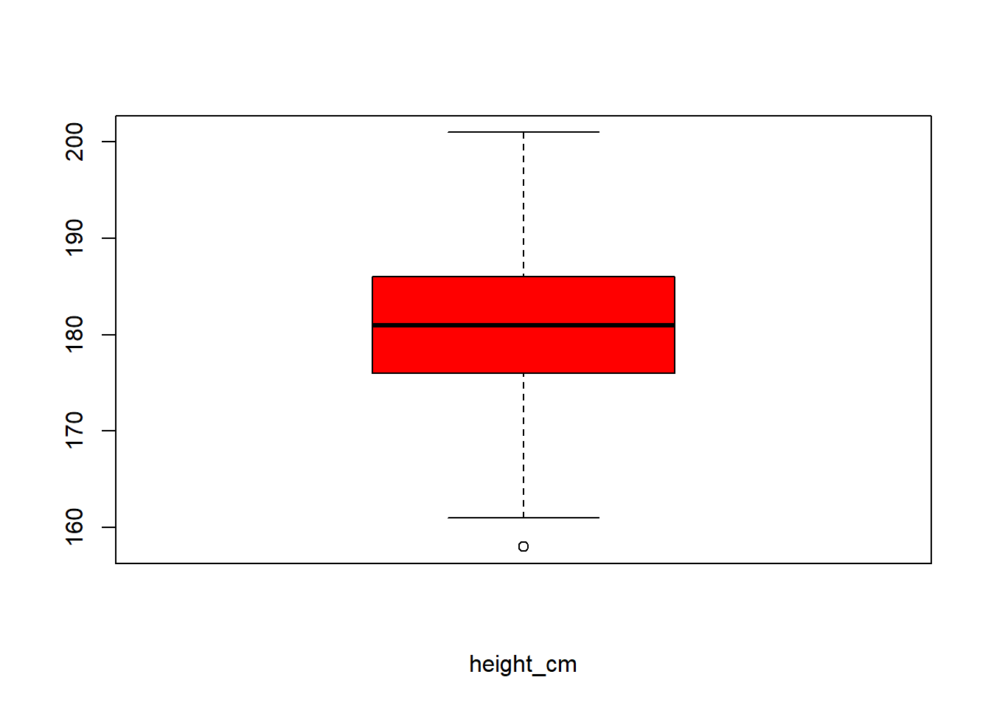
GRAPHICAL REPRESENTATION OF DATA: 1.BOX PLOT
THE BOX-PLOT OF THE OVERALL , POTENTIAL RATING AND AGE HAS SEVERAL OUTLIERS

Slide 9
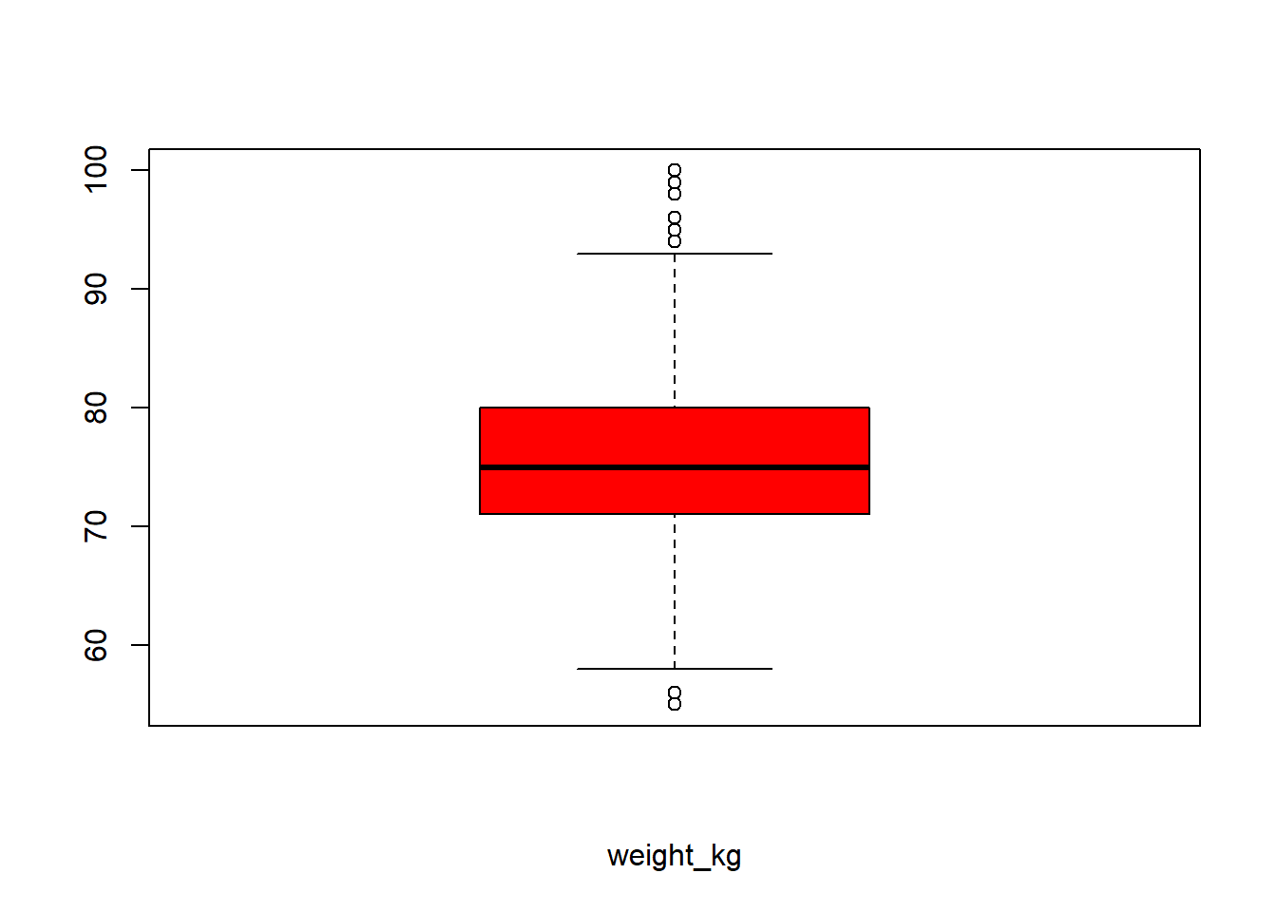
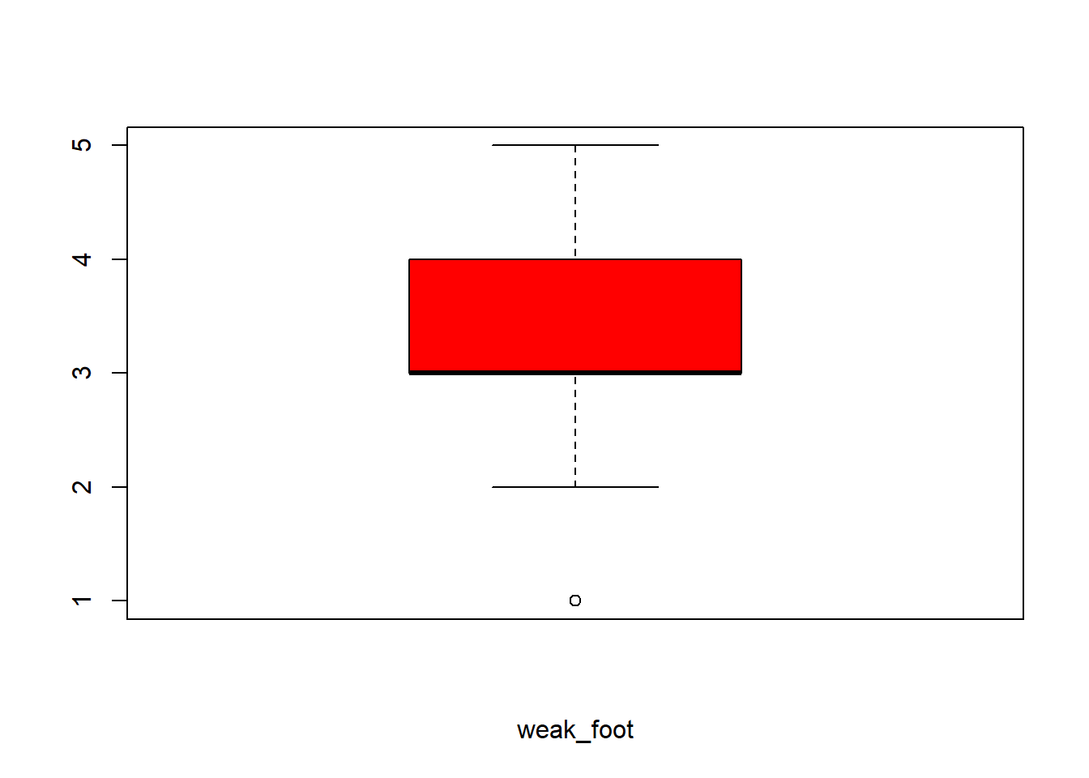
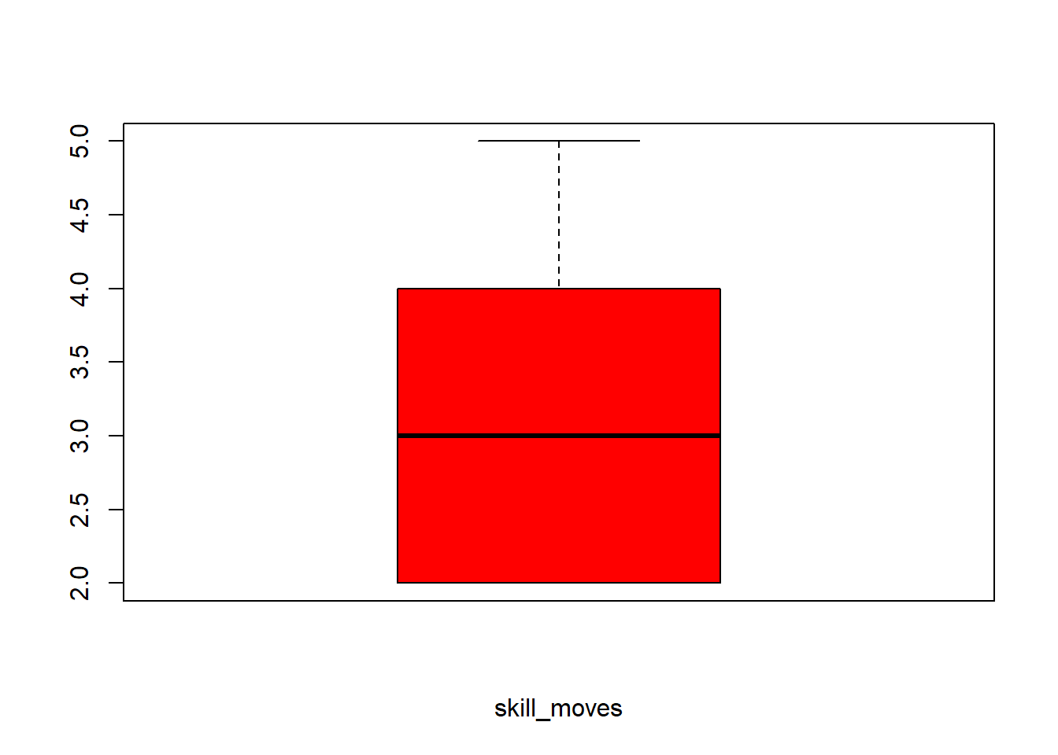
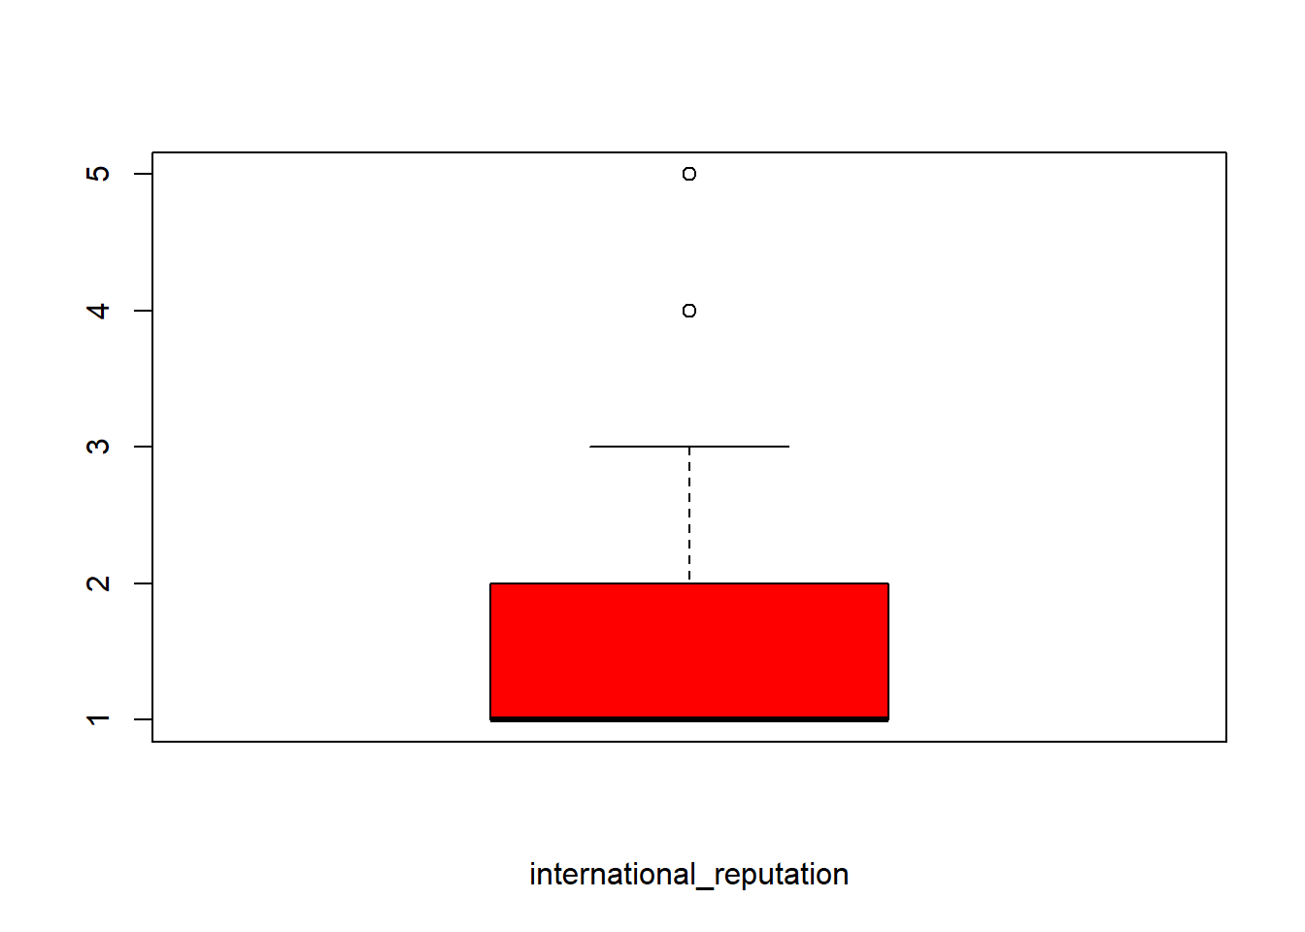
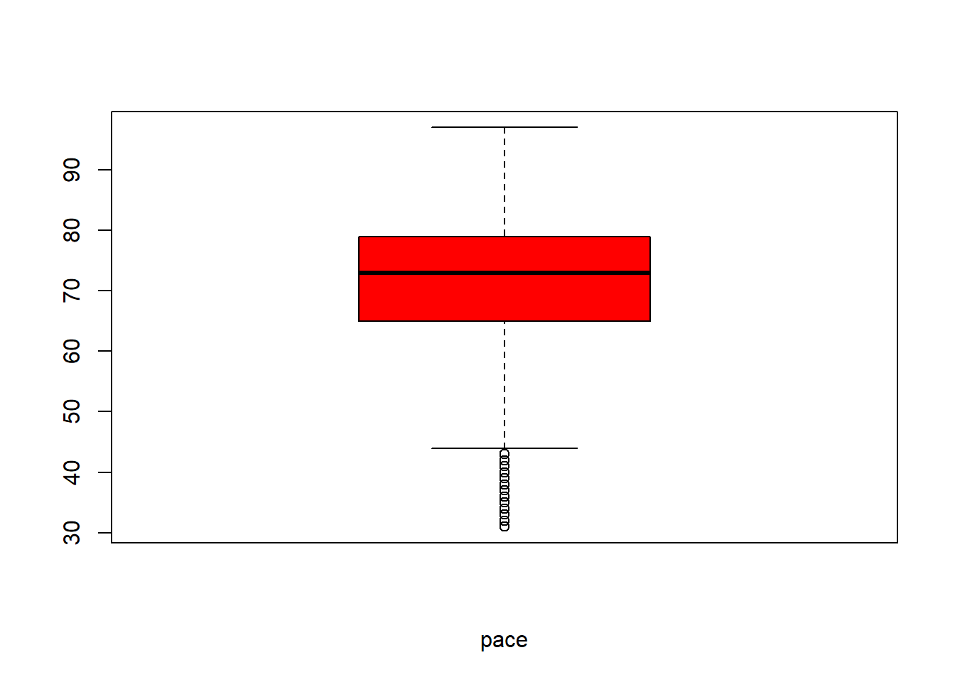

THE BOX-PLOT OF THE WEIGHT AND THE PACE RATING HAS SEVERAL OUTLIERS

Slide 10

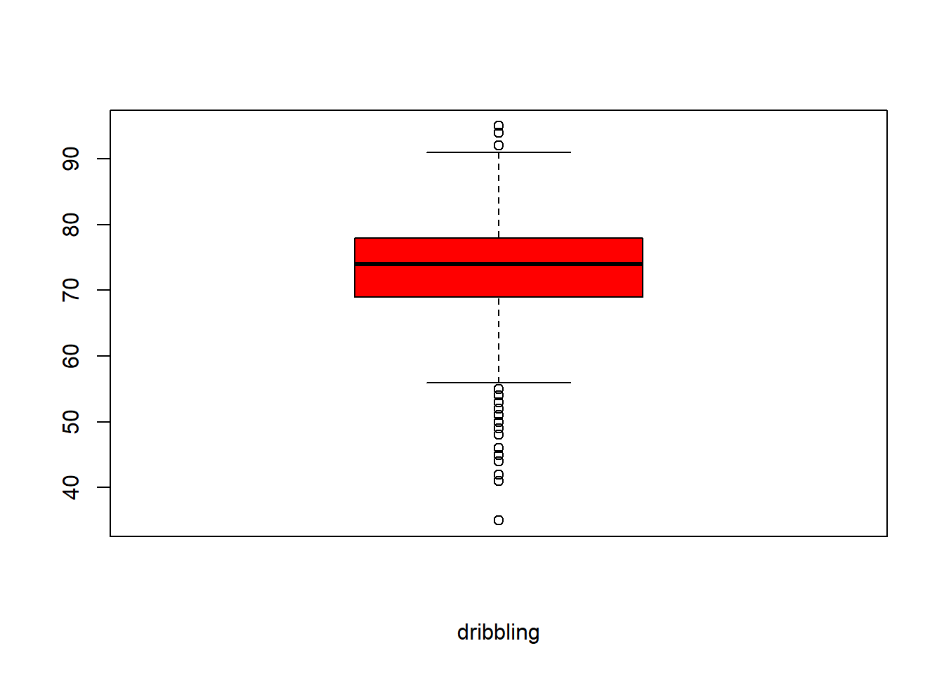

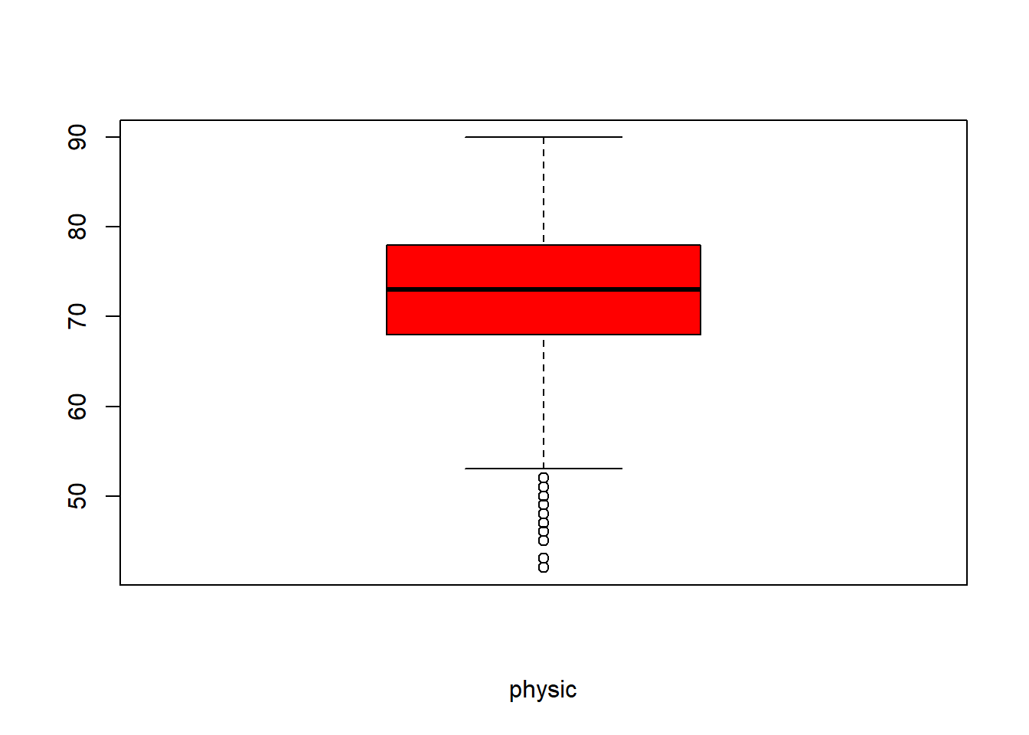
THE WEIGHT AND THE PACE RATING HAS SEVERAL OUTLIERS

Slide 11
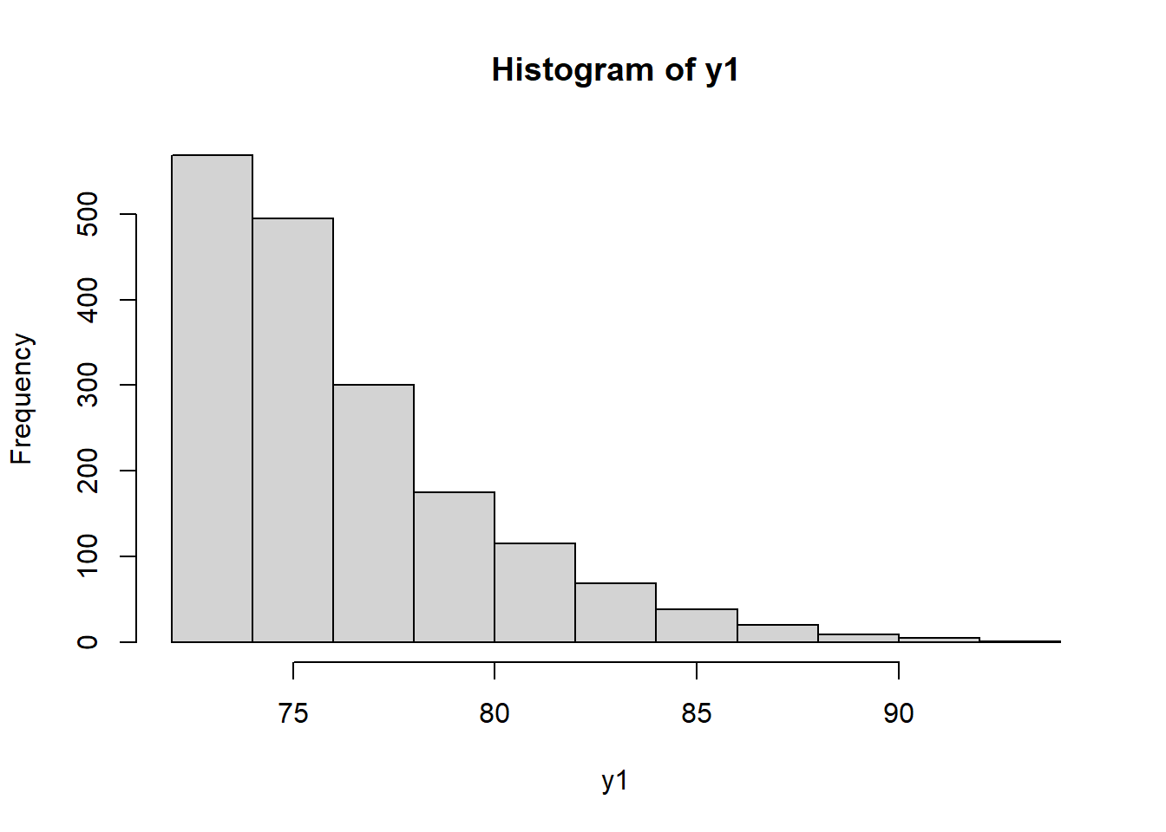
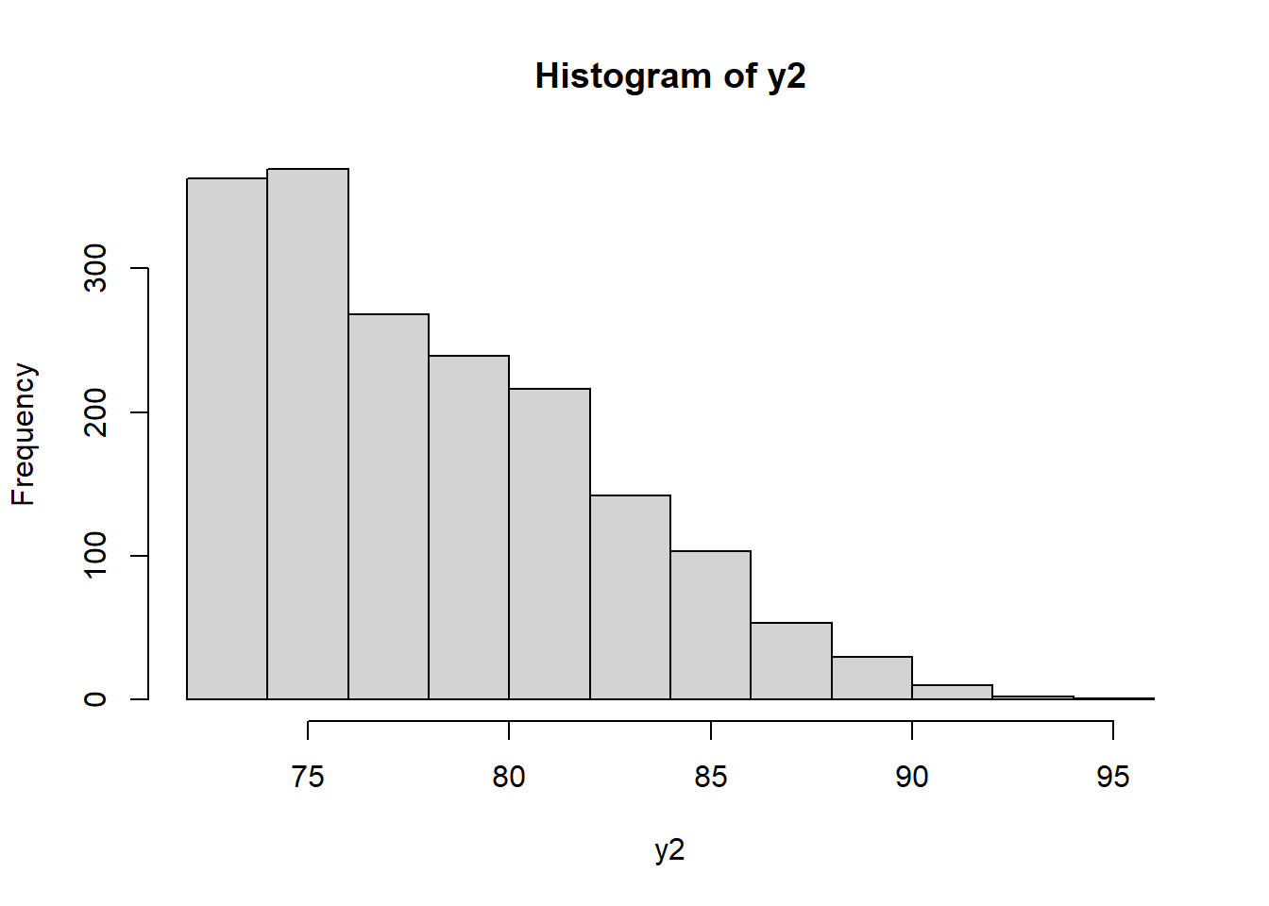
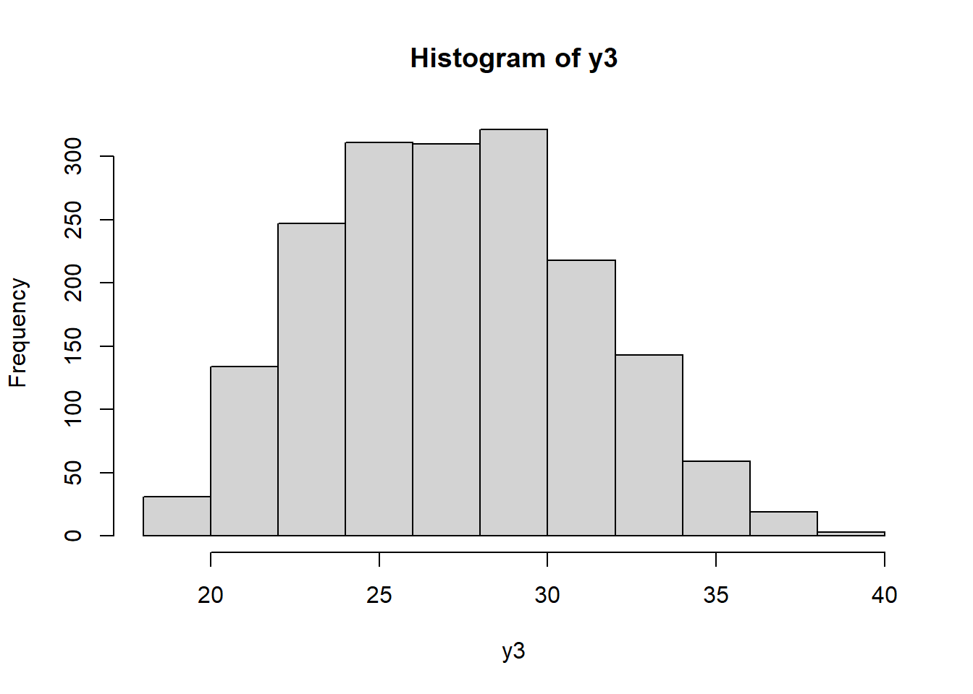
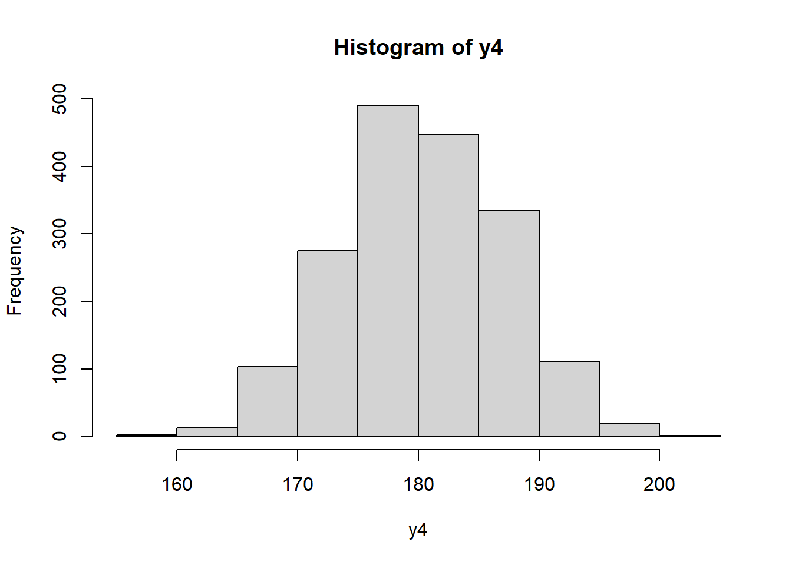
2.HISTOGRAM
POTENTIAL RATING(Y2) IT IS A POSITIVELY SKEWED DATA AND IT DOES NOT FOLLOW NORMAL
OVERALL RATING(Y1) IS A POSITIVELY SKEWED DATA AND IT DOES NOT FOLLOW NORMAL
AGE(Y3) IT IS A BELL-SHAPED DATA AND IT MAY FOLLOW NORMAL DISTRIBUTION
HEIGHT(Y4) IT IS A BELL-SHAPED DATA AND IT MAY FOLLOW NORMAL DISTRIBUTION

Slide 12
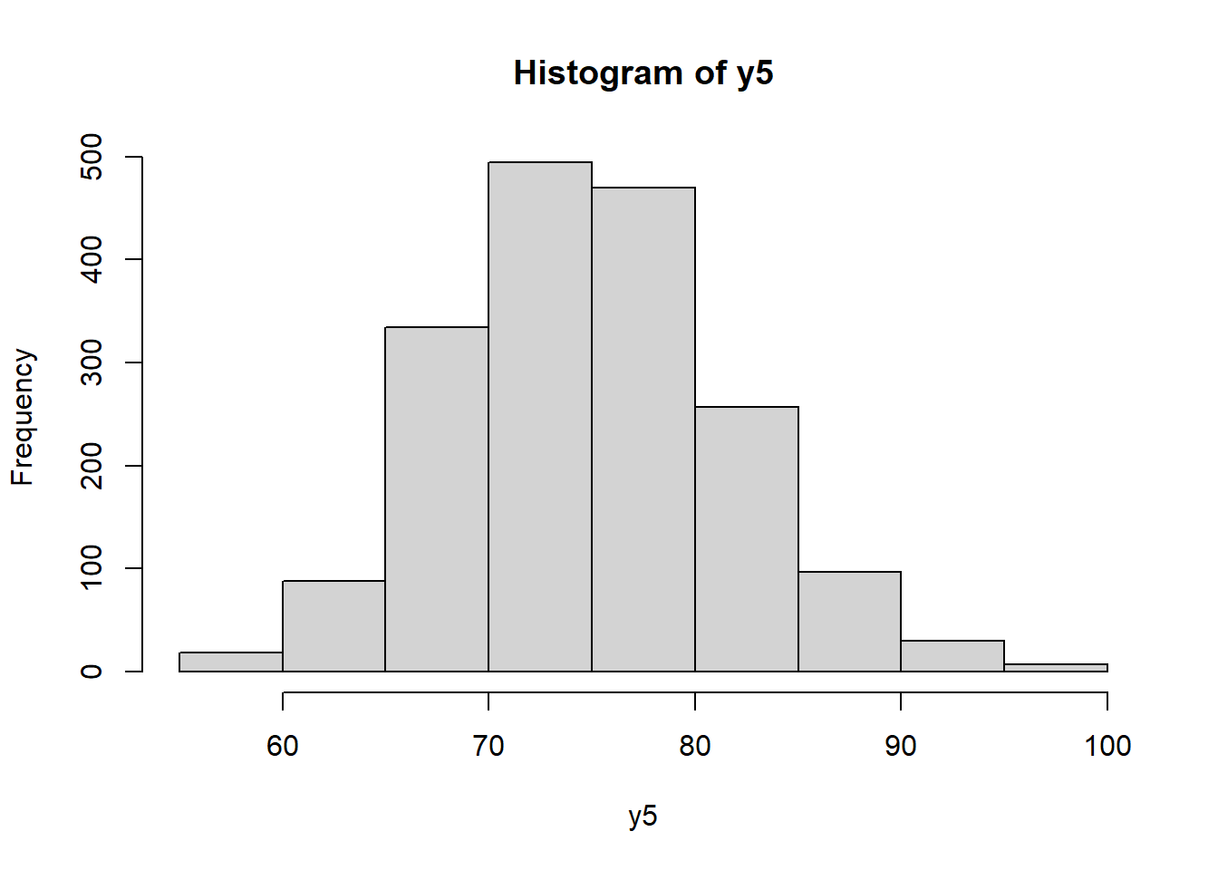
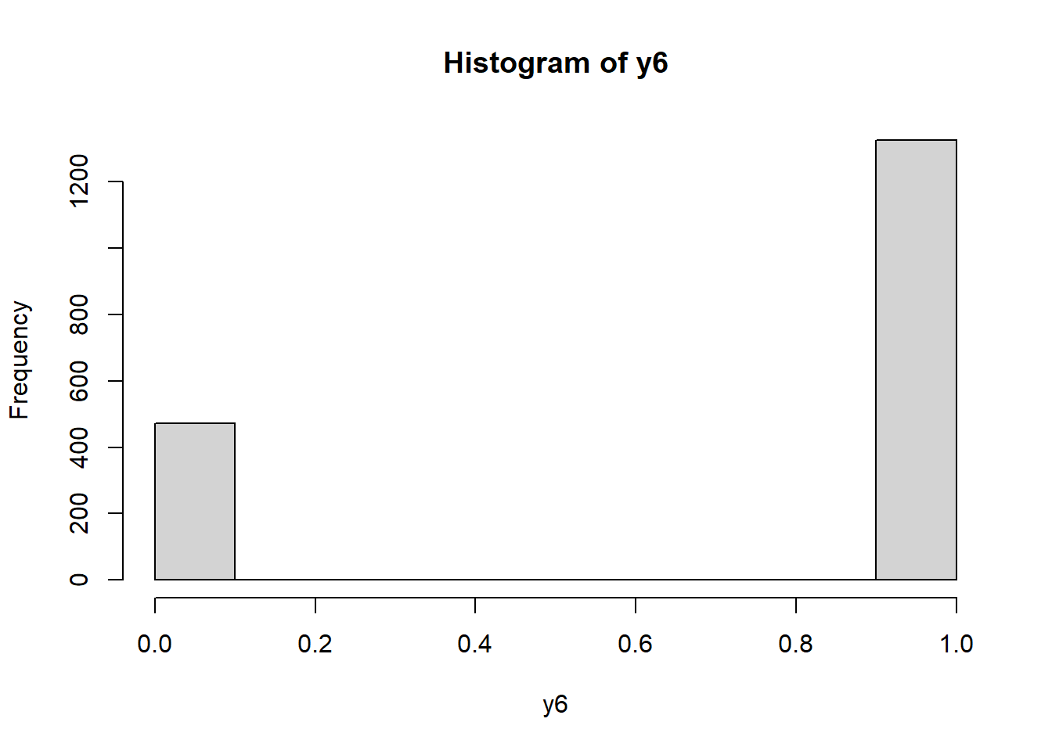
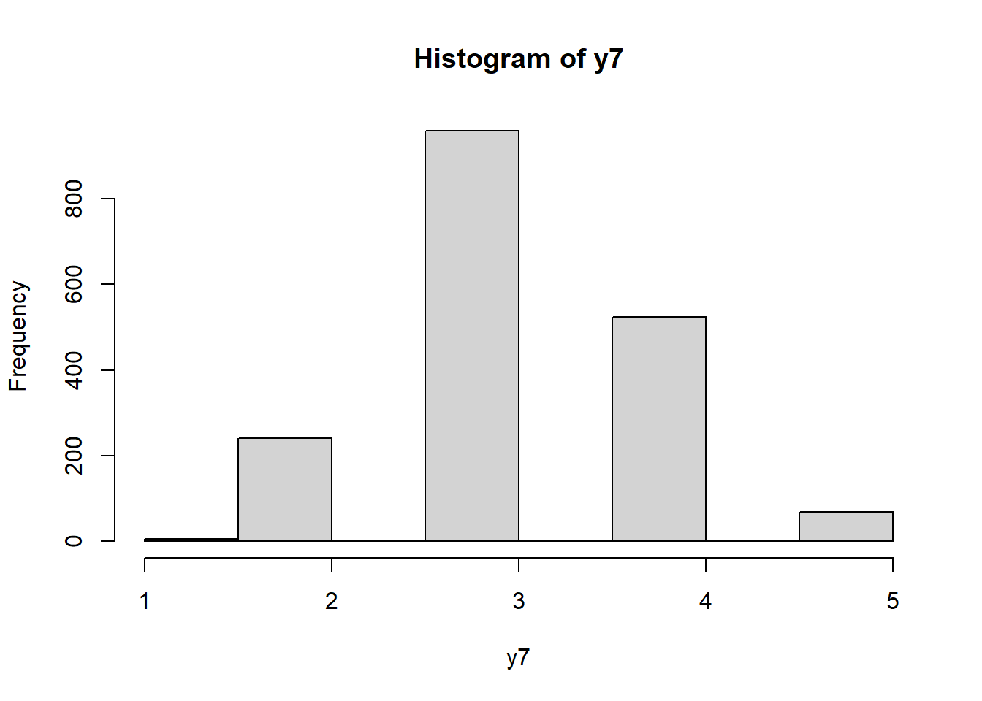
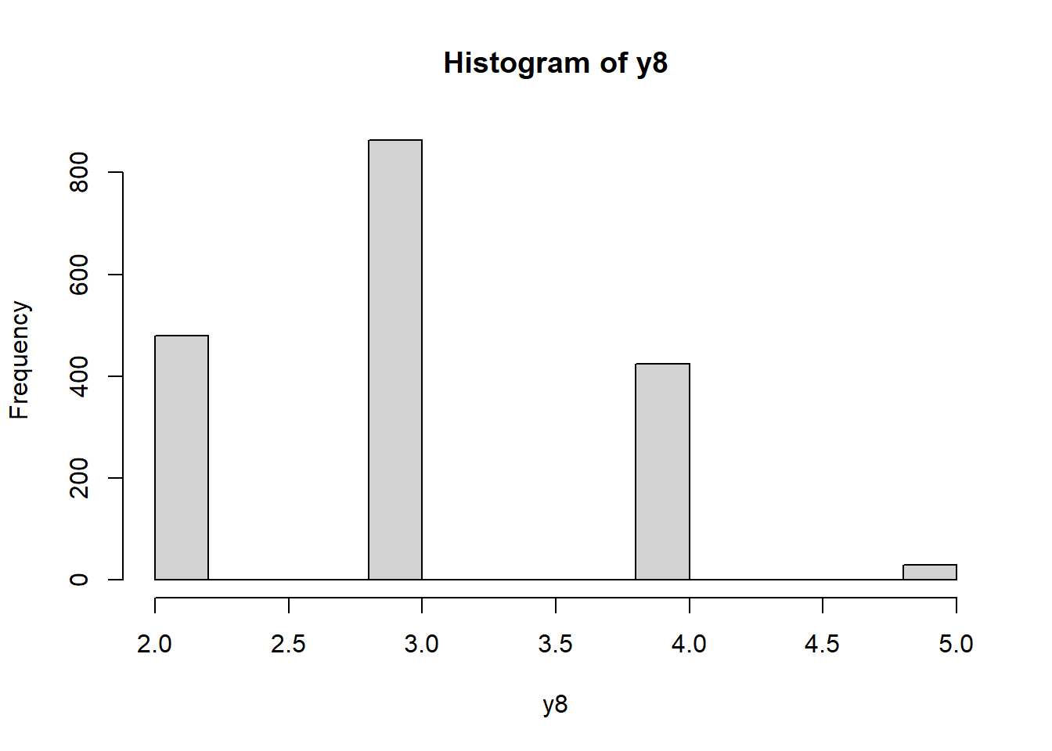
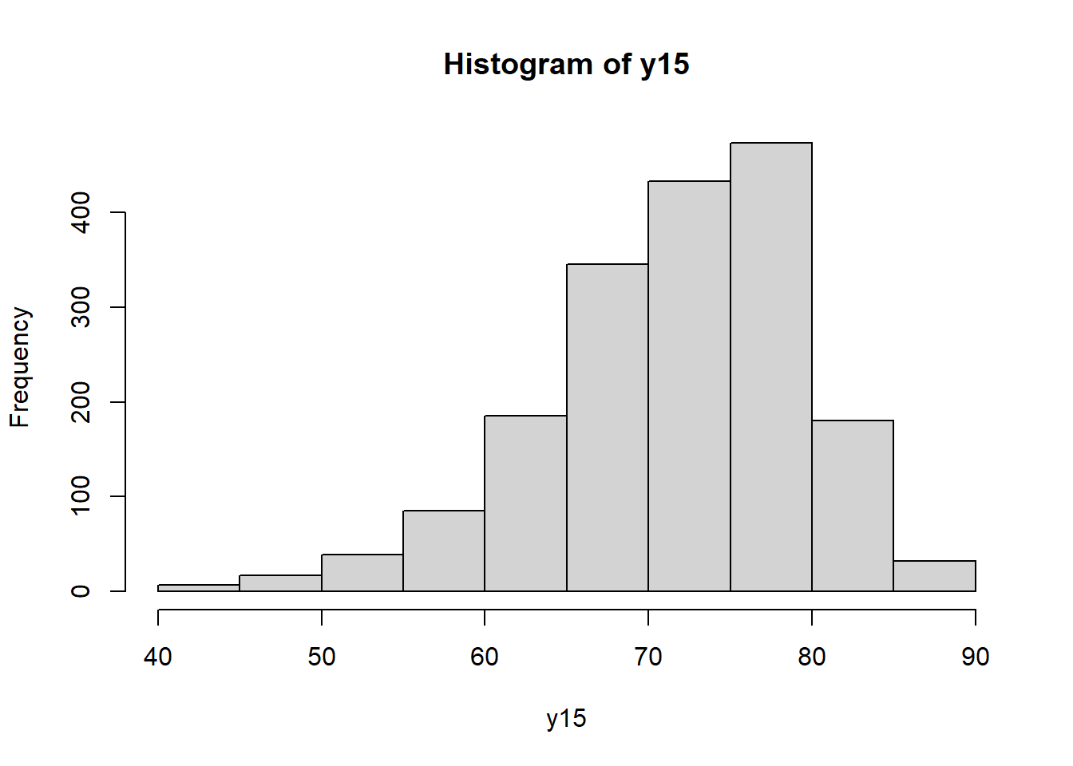
WEIGHT (Y5) IT IS A BELL-SHAPED DATA AND IT MAY FOLLOW NORMAL DISTRIBUTION
PREFERRED FOOT(Y6) IS A NEGATIVELY SKEWED DATA
WEAK FOOT(Y7) IS A BELL SHAPED DATA
SKILL MOVES (Y8) IS A BELL SHAPED DATA
PHYSIC RATING(Y15) IS A NEGATIVELY SKEWED DATA AND IT DOES NOT FOLLOW NORMAL

Slide 13
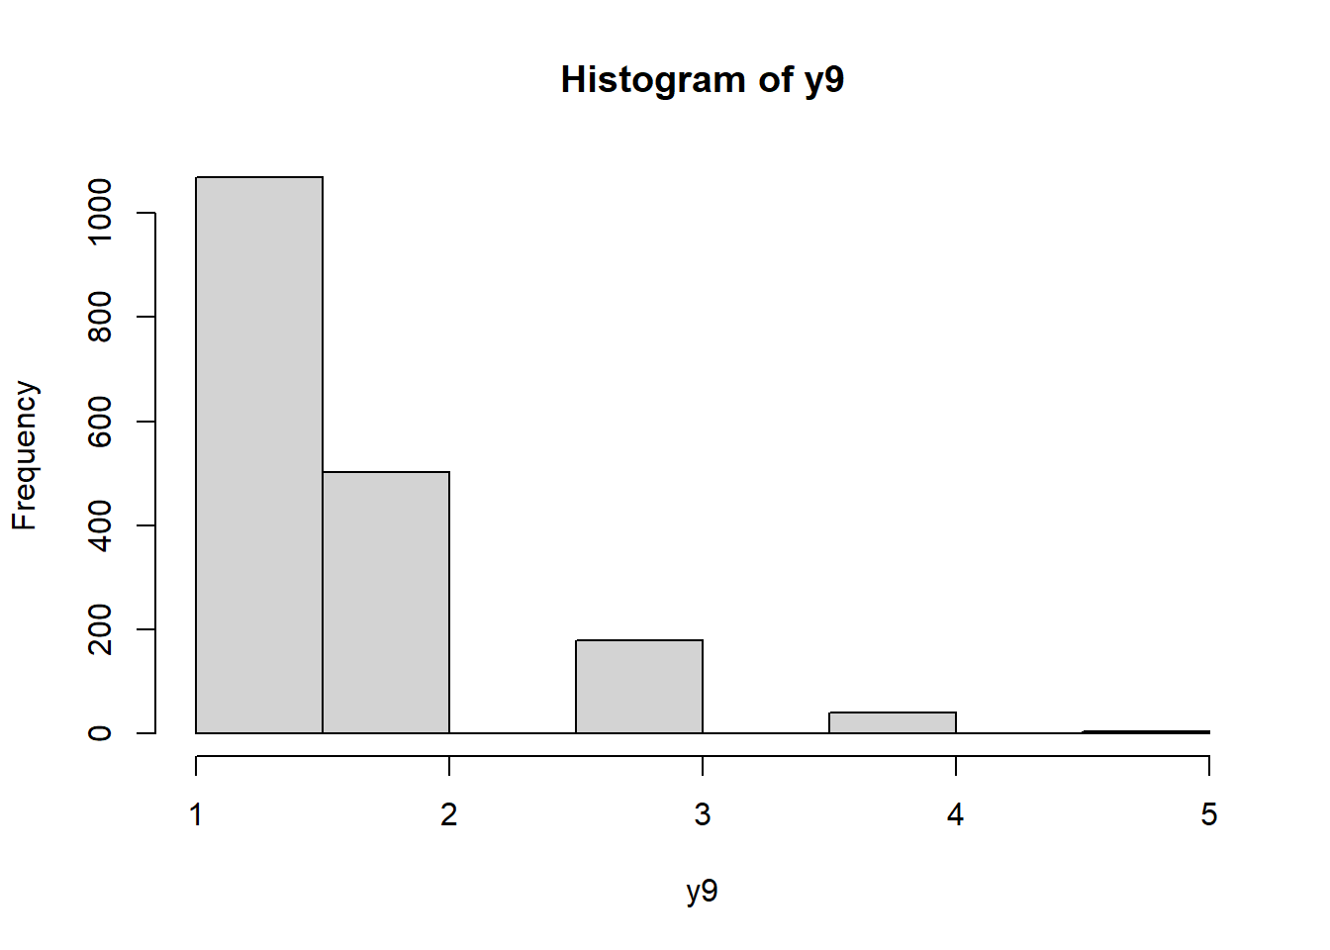
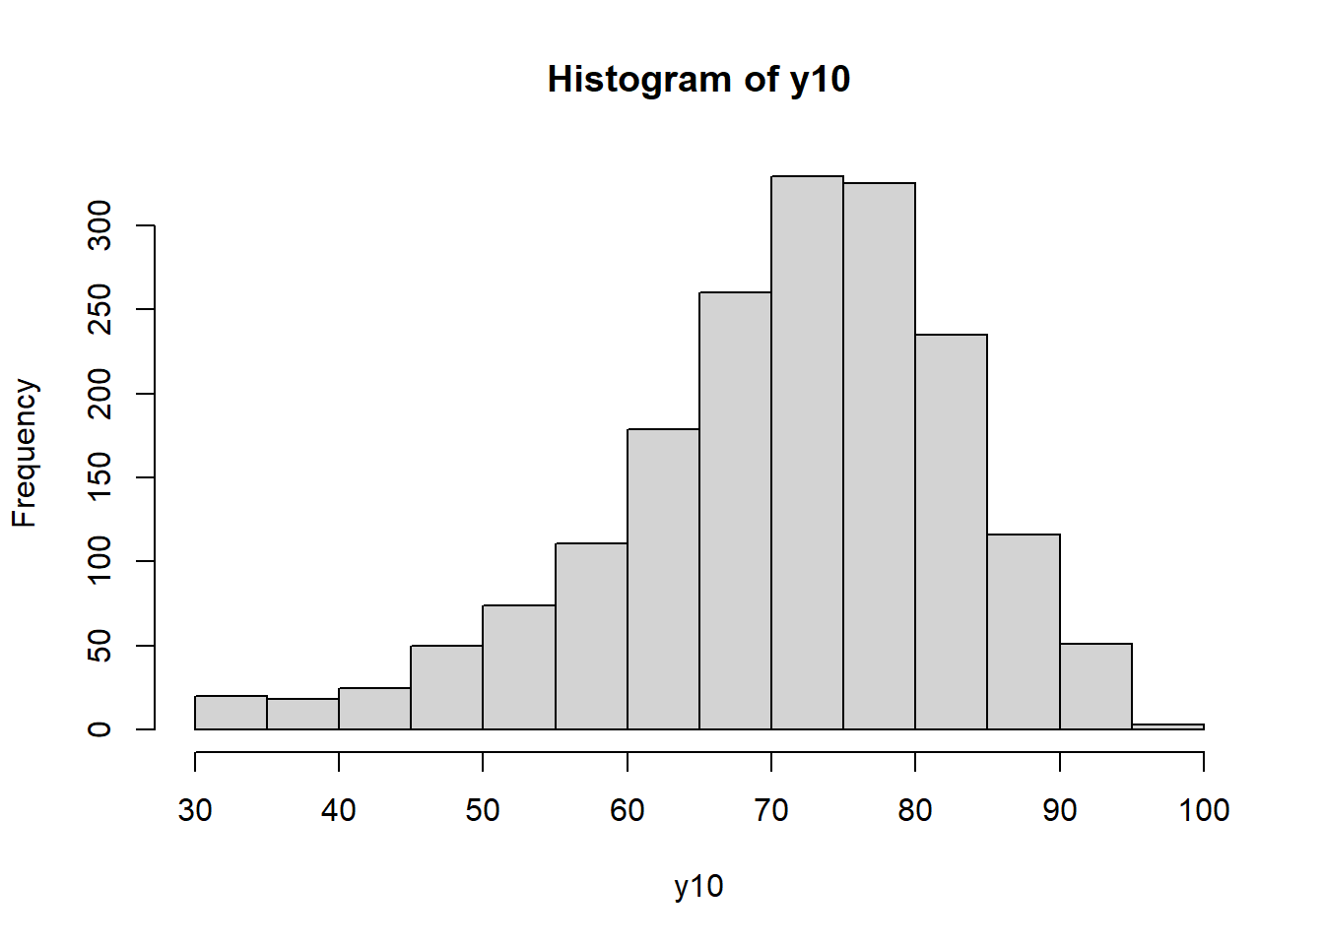
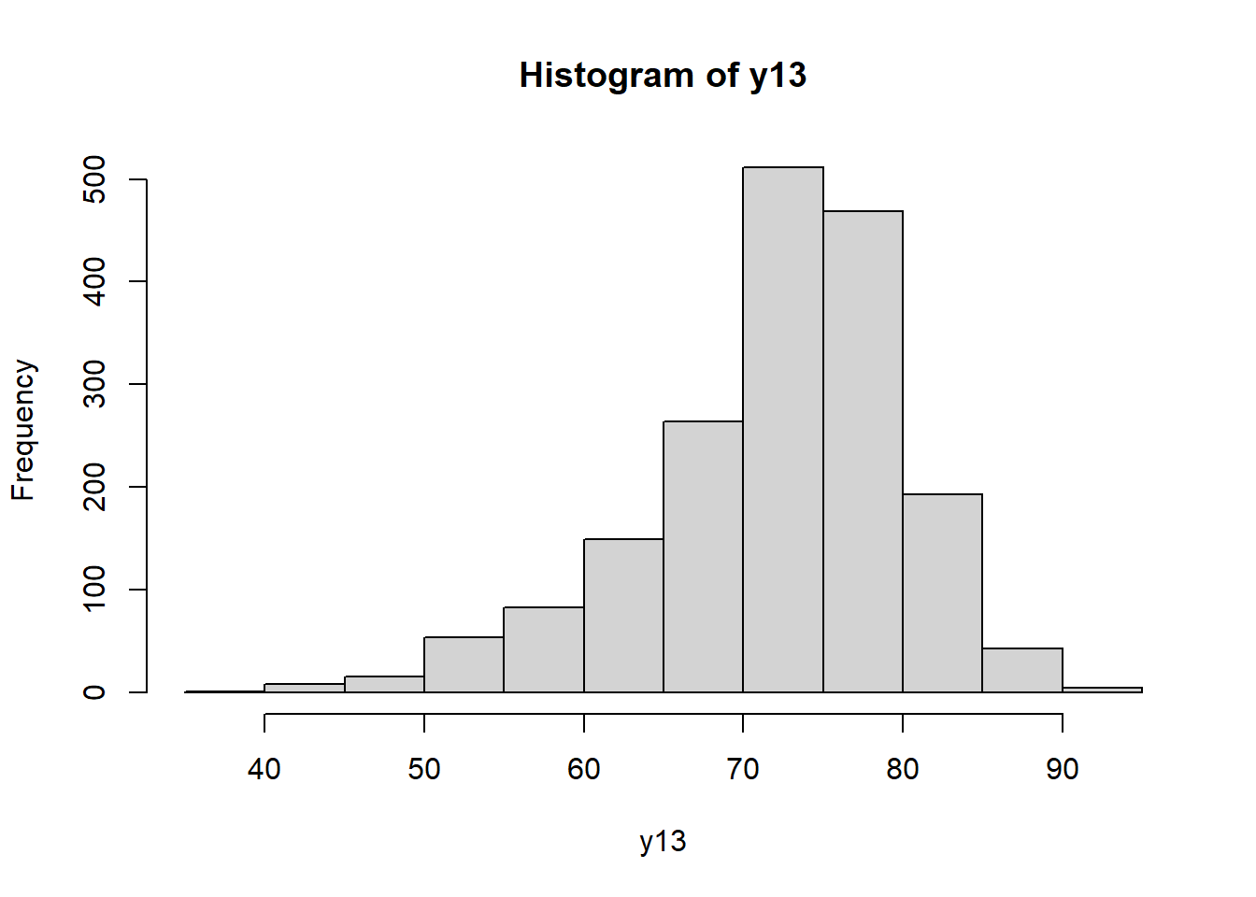
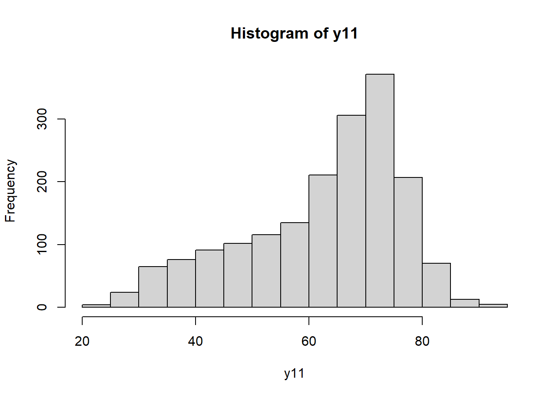
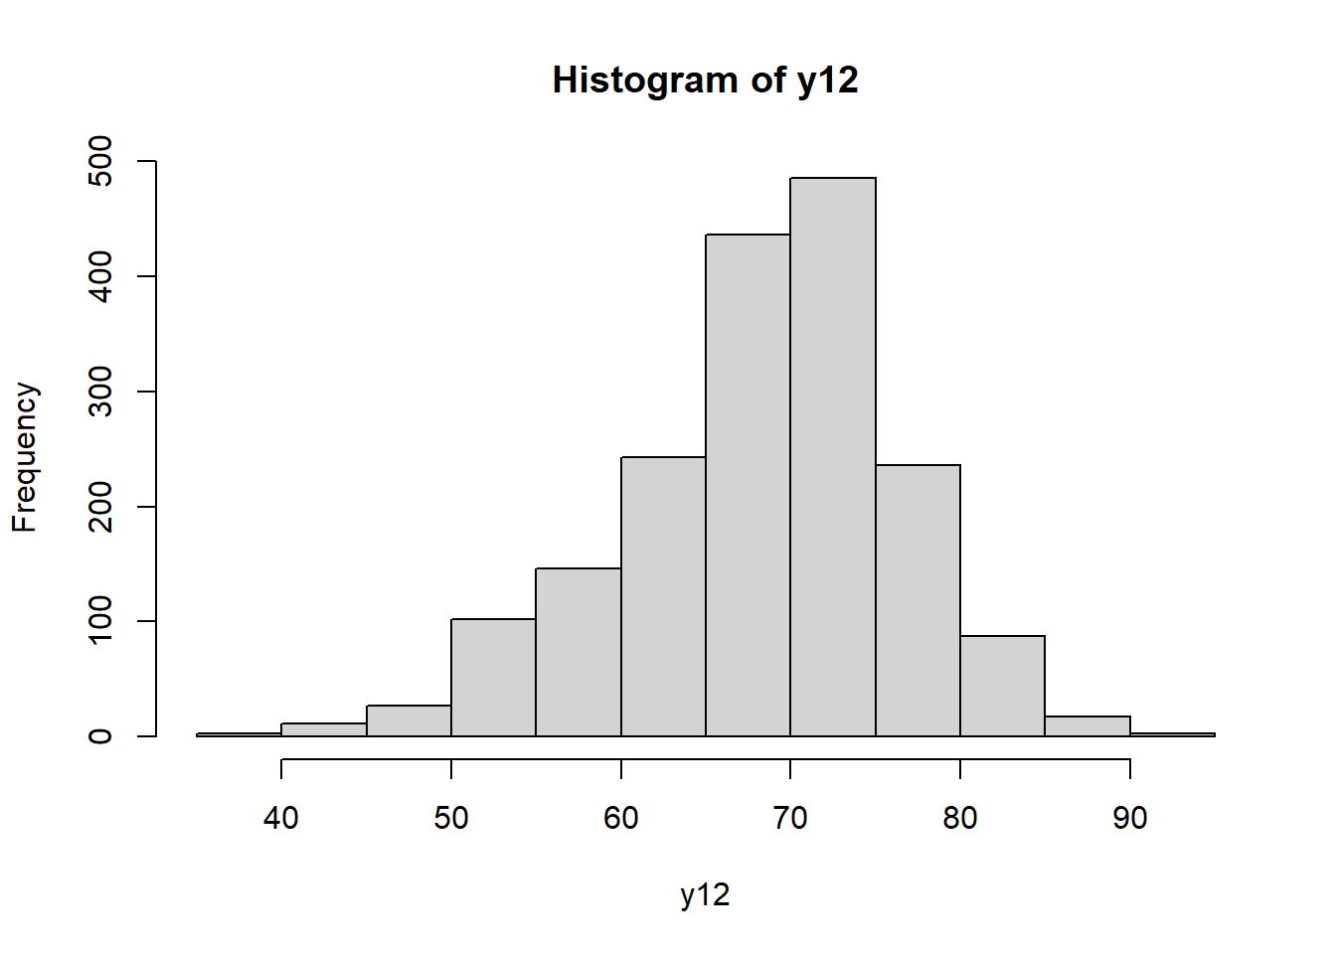
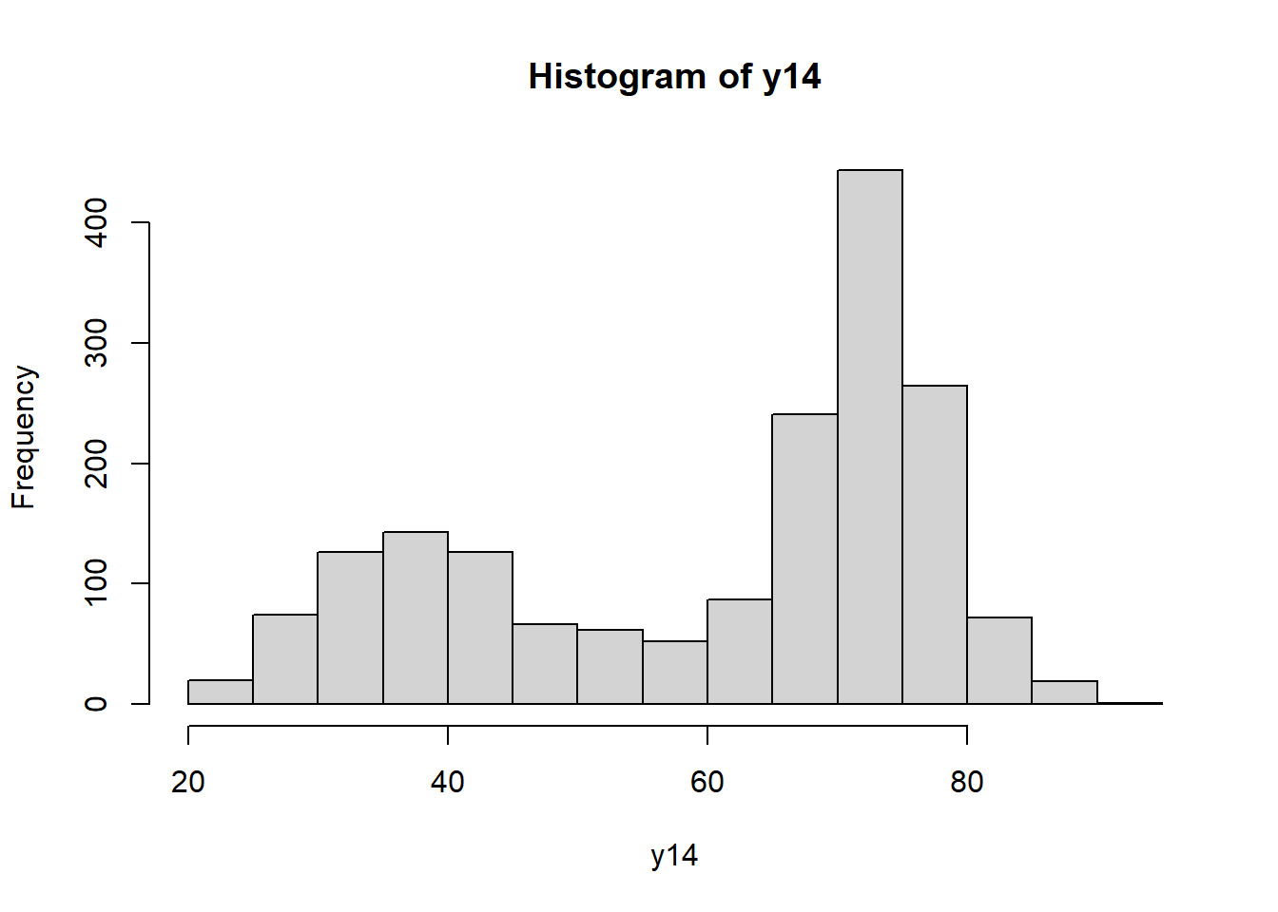
PACE RATING(Y10) IS A NEGATIVELY SKEWED DATA AND IT DOES NOT FOLLOW NORMAL
DRIBBLING RATING(Y13) IS A NEGATIVELY SKEWED DATA AND IT DOES NOT FOLLOW NORMAL
INTERNATIONAL REPUTATION (Y9) IS A POSITIVELY SKEWED
SHOOTING RATING(Y11) IS A NEGATIVELY SKEWED DATA AND IT DOES NOT FOLLOW NORMAL
PASSING RATING(Y12) IS A NEGATIVELY SKEWED DATA AND IT DOES NOT FOLLOW NORMAL
DEFENDING RATING(Y14) IS A MIXED DATA AND IT DOES NOT FOLLOW NORMAL

Slide 14
Shapiro-Wilk test
Shapiro-Wilk normality test | Shapiro-Wilk normality test | Shapiro-Wilk normality test | Shapiro-Wilk normality test
Y1 | Y2 | Y3 | Y4
W= 0.8698 | W= 0.93477 | W= 0.98817 | W= 0.99582
p-VALUE= < 2.2e-16 | p-VALUE= < 2.2e-16 | p-VALUE= 5.853e-11 | p-VALUE= 7.06e-05
From the output,here all the p-values < 0.05 implying that our null hypothesis i.e the data are normally distributed is rejected. In other words, we can assume that the data does not hold the normality.
Shapiro-Wilk normality test | Shapiro-Wilk normality test | Shapiro-Wilk normality test | Shapiro-Wilk normality test
Y5 | Y10 | Y11 | Y12
W= 0.99394 | W= 0.96626 | W= 0.93674 | W= 0.97982
p-VALUE= 1.021e-06 | p-VALUE= < 2.2e-16 | p-VALUE= < 2.2e-16 | p-VALUE= 3.184e-15
Shapiro-Wilk normality test | Shapiro-Wilk normality test | Shapiro-Wilk normality test
Y13 | Y14 | Y15
W= 0.95607 | W= 0.87997 | W= 0.96871
p-VALUE= < 2.2e-16 | p-VALUE= < 2.2e-16 | p-VALUE= < 2.2e-16

Slide 15
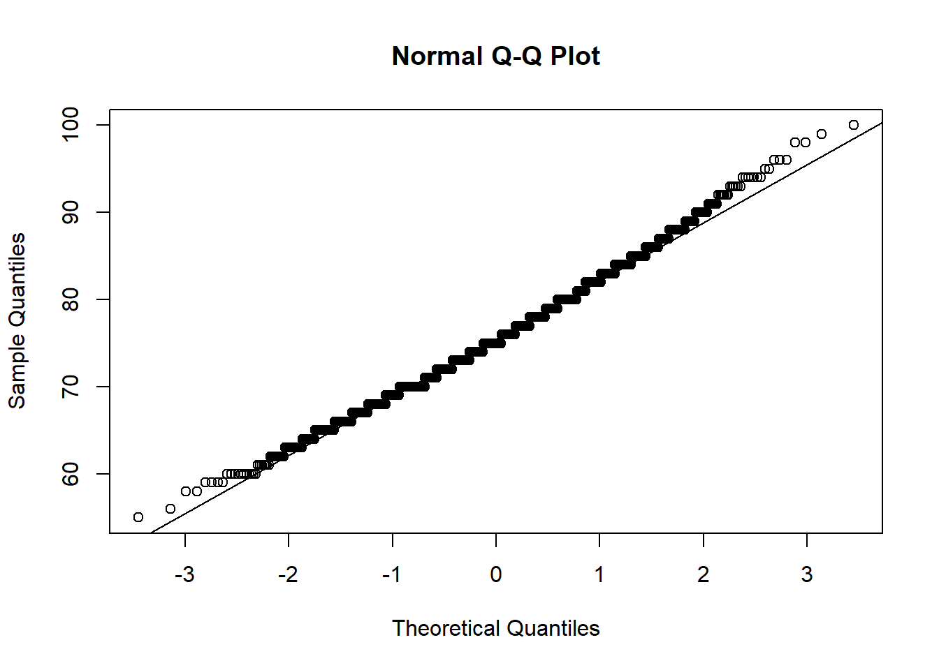
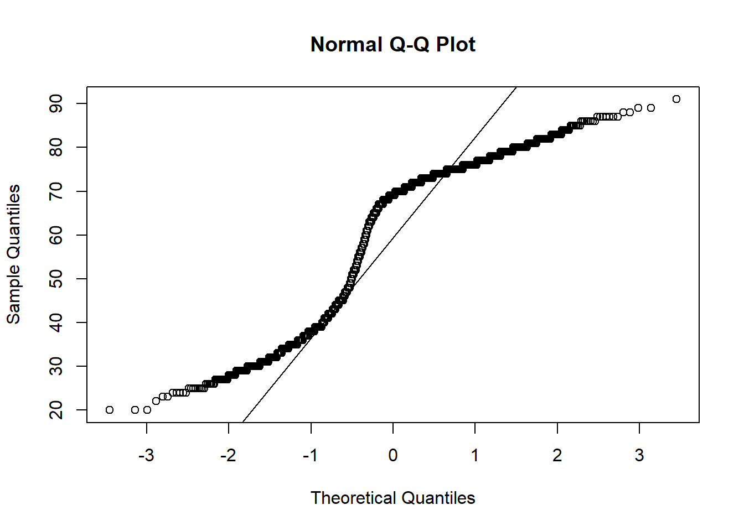
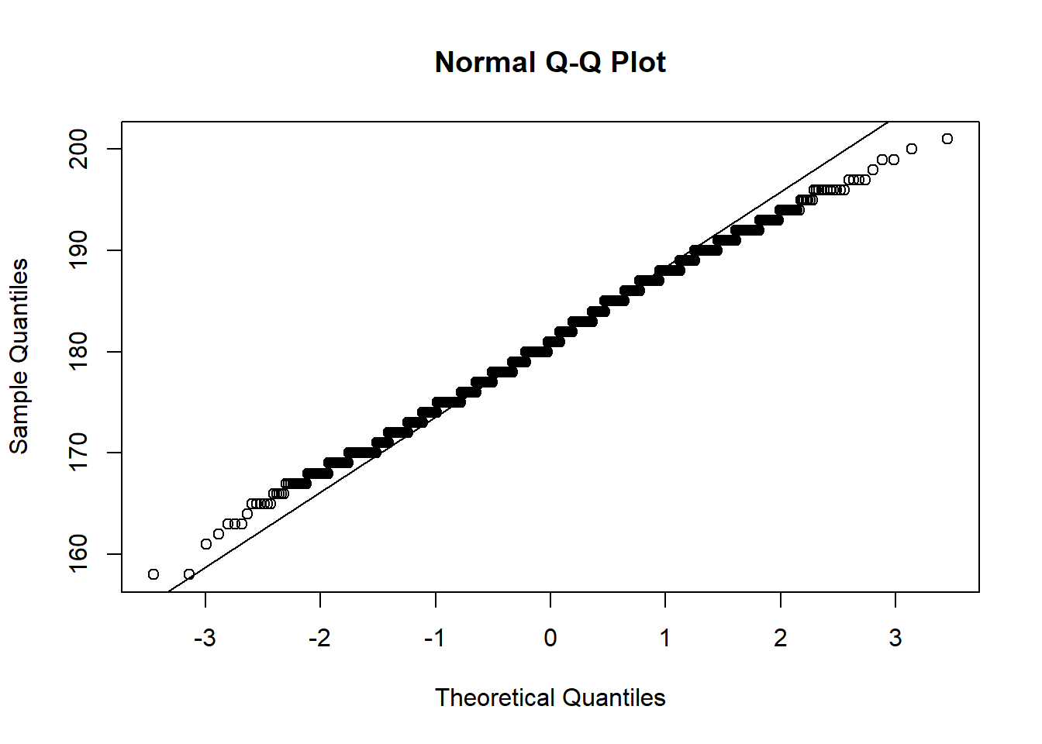
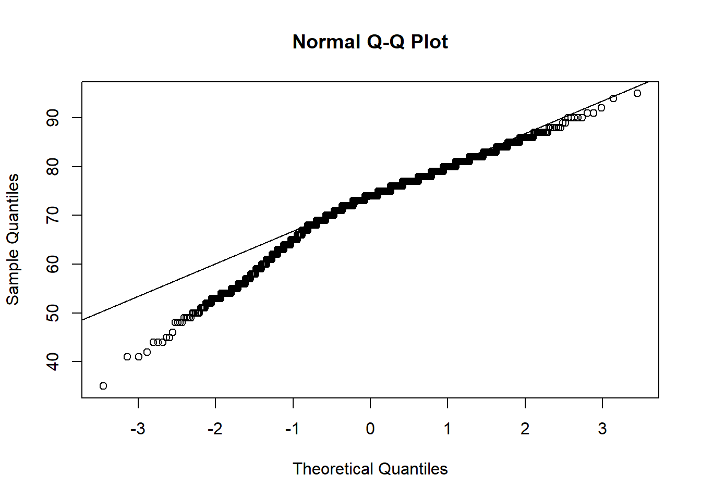
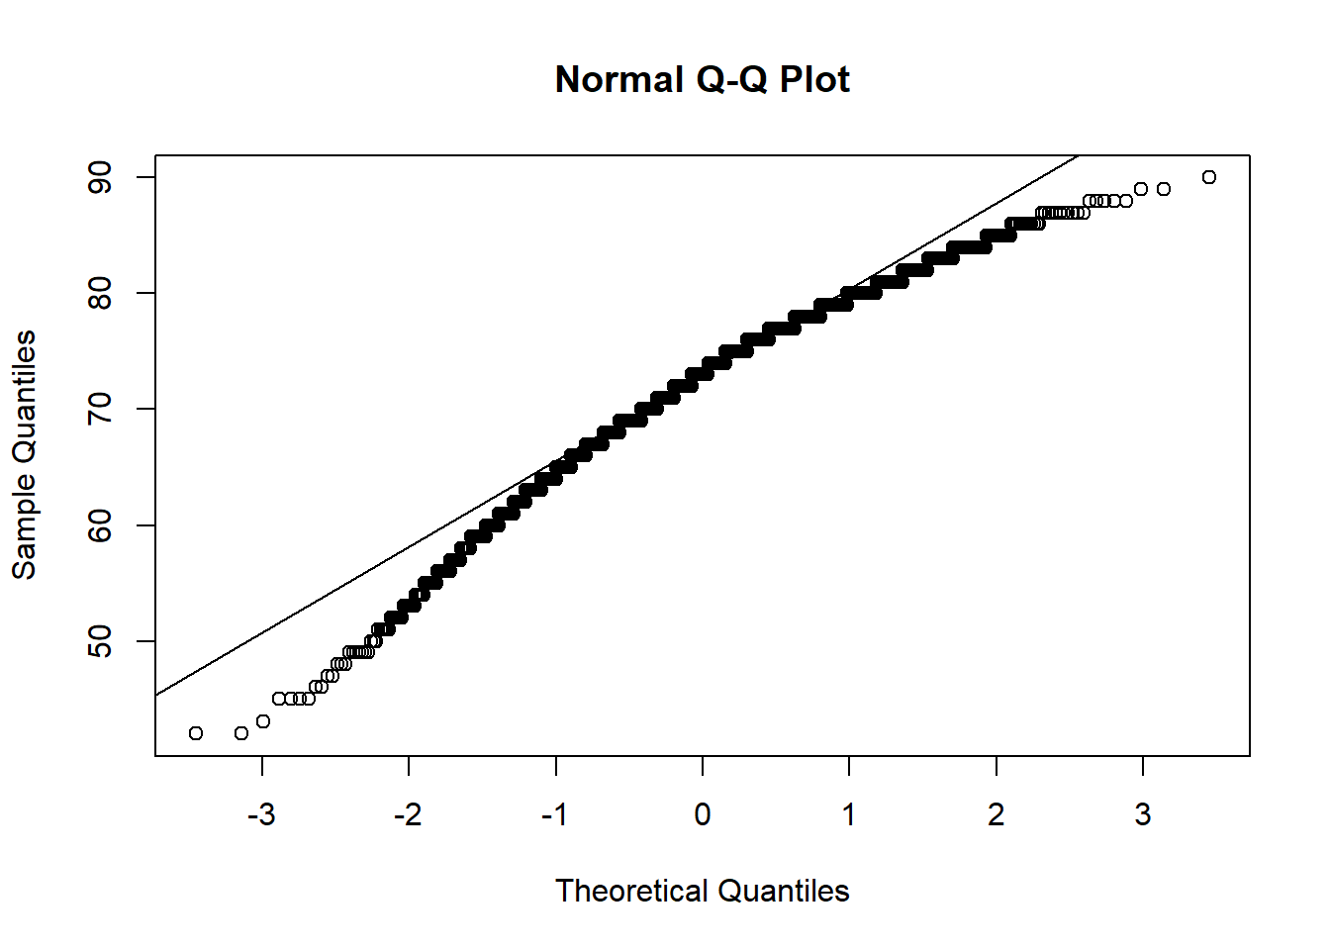
NORMAL Q-Q PLOT
We can see the clear departure from straight line in this Q-Q plot ,indicating that the dataset likely does not follow a normal distribution.

Slide 16
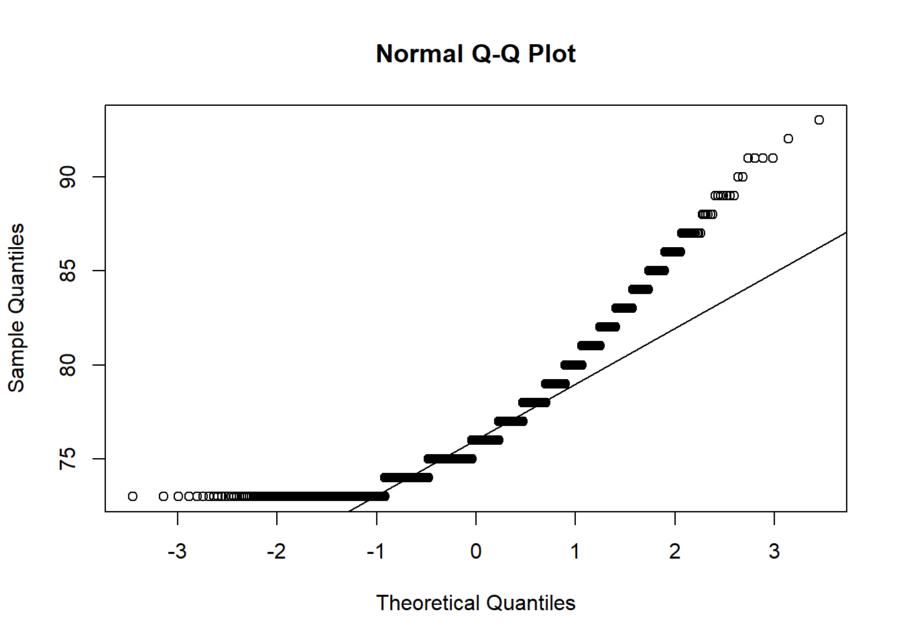
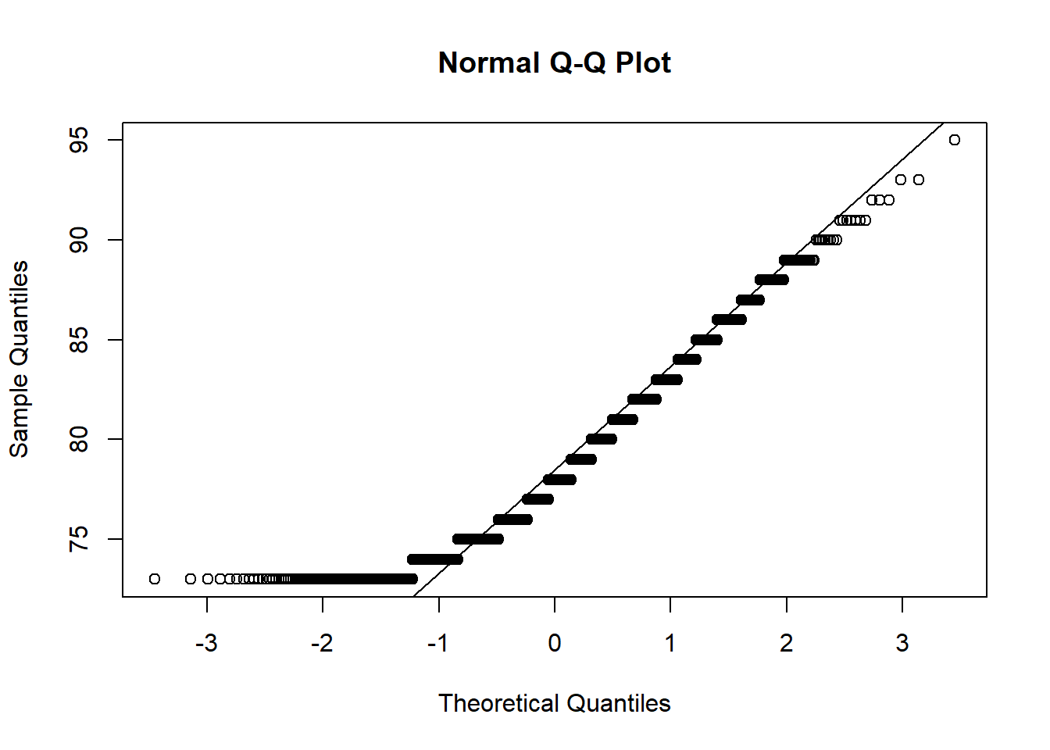
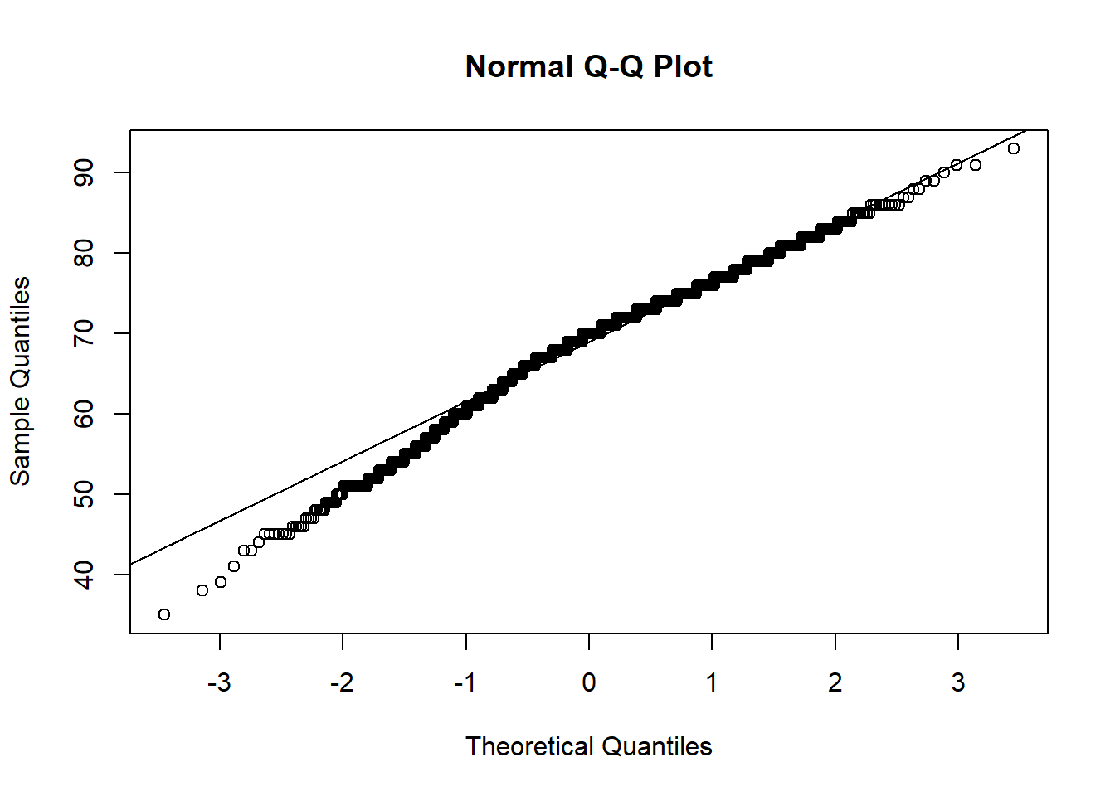
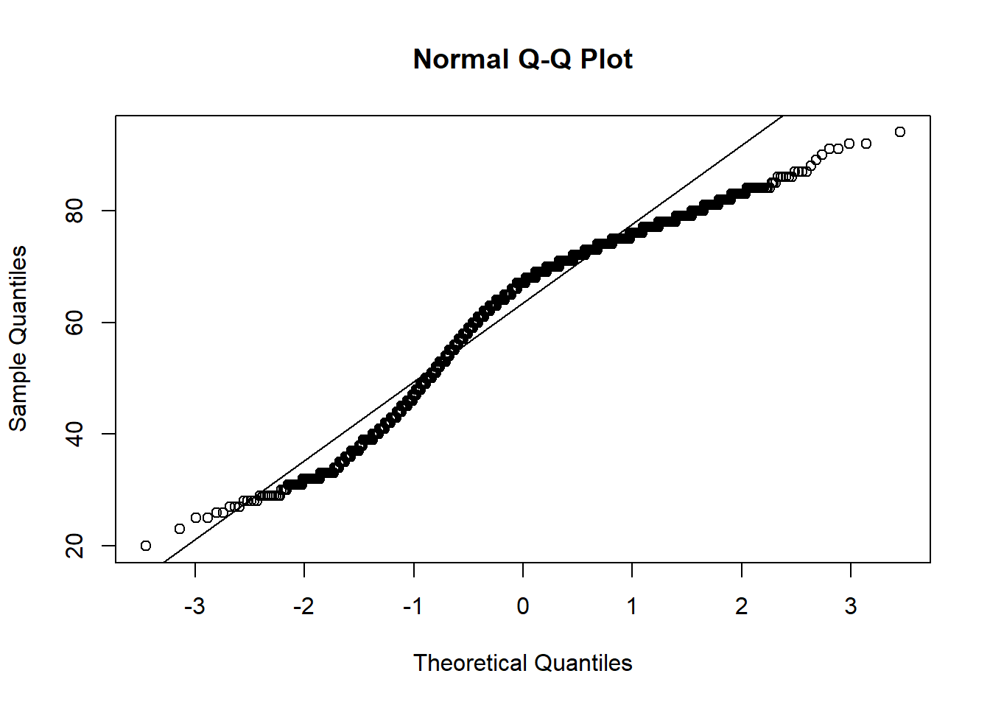
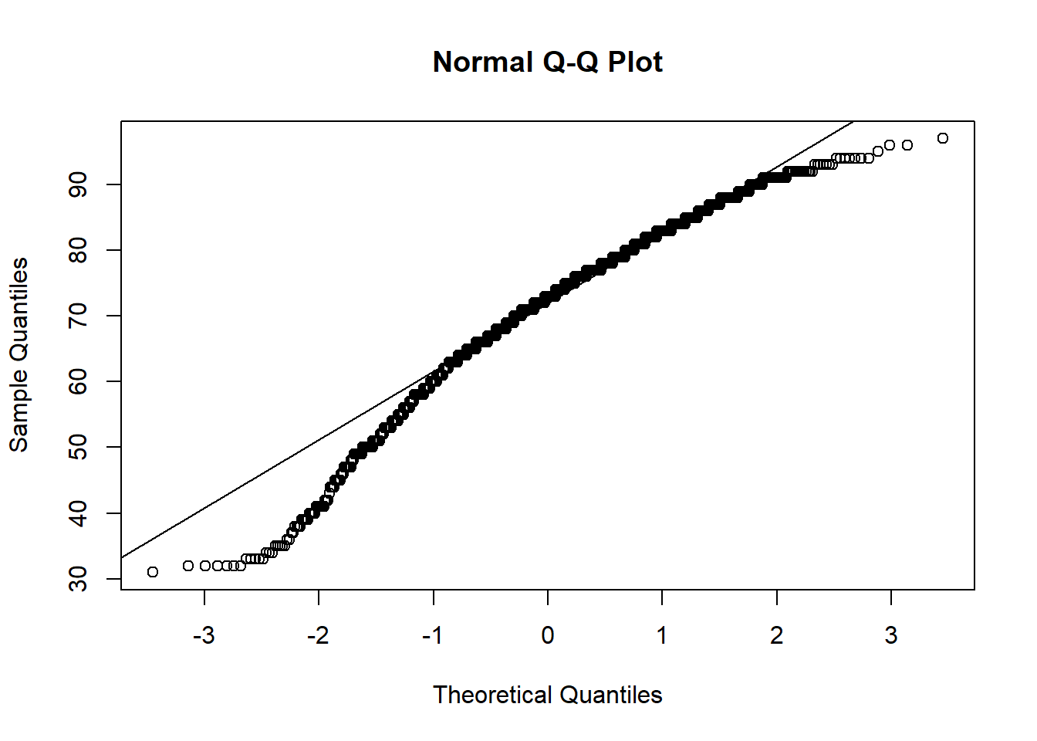
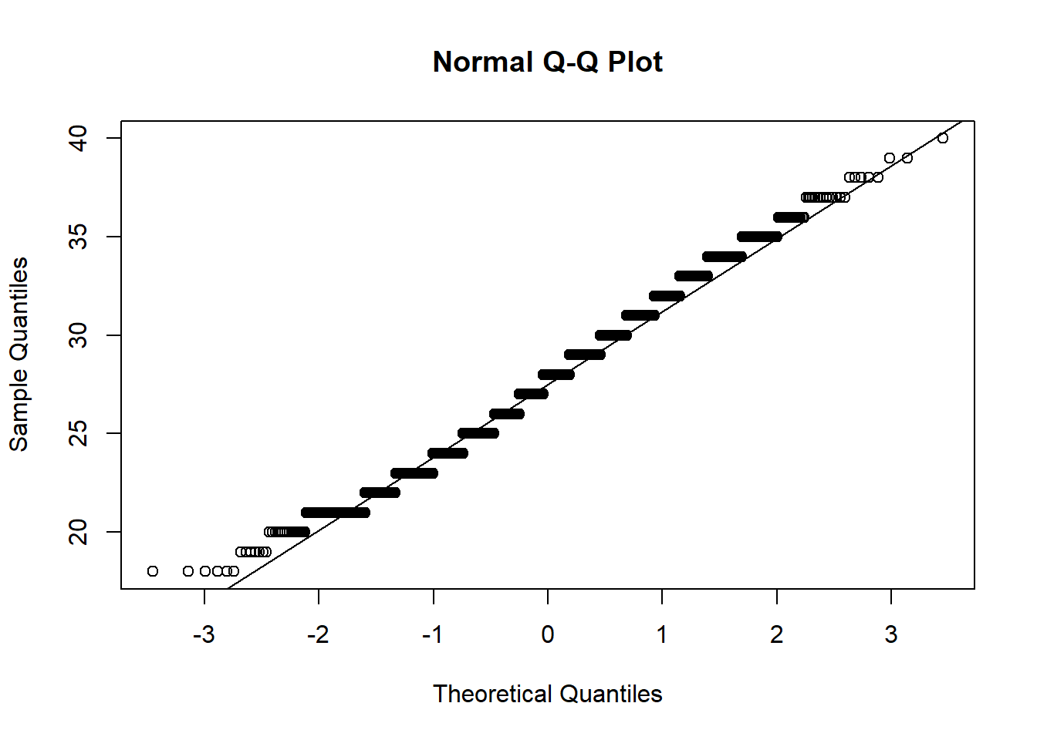
We can see the clear departure from straight line in this Q-Q plot ,indicating that the dataset likely does not follow a normal distribution.

Slide 17
NON-PARAMETRIC TEST
1.One sample Kolmogorov Smirnov test:-(to check whether the data come from a normal distribution or not)
FROM THE OUTPUT WE CAN SEE THAT THE TEST STATISTIC IS 1 AND THE CORRESPONDING p-VALUE IS 2.2e-16.SINCE THE p-VALUE IS LESS THAN 0.05 WE REJECT THE NULL HYPOTHESIS.WE HAVE SUFFICIENT EVIDENCE TO SAY THAT THE SAMPLE DATA DOES NOT COME FROM A NORMAL DISTRIBUTION.
One-sample Kolmogorov-Smirnov test | One-sample Kolmogorov-Smirnov test | One-sample Kolmogorov-Smirnov test
data: y1 | data: y2 | data: y3
D = 1 | D = 1 | D = 1
p-value < 2.2e-16 | p-value < 2.2e-16 | p-value < 2.2e-16
One-sample Kolmogorov-Smirnov test | One-sample Kolmogorov-Smirnov test | One-sample Kolmogorov-Smirnov test
data: y4 | data: y5 | data: y10
D = 1 | D = 1 | D = 1
p-value < 2.2e-16 | p-value < 2.2e-16 | p-value < 2.2e-16
One-sample Kolmogorov-Smirnov test | One-sample Kolmogorov-Smirnov test | One-sample Kolmogorov-Smirnov test
data: y11 | data: y12 | data: y13
D = 1 | D = 1 | D = 1
p-value < 2.2e-16 | p-value < 2.2e-16 | p-value < 2.2e-16
One-sample Kolmogorov-Smirnov test | One-sample Kolmogorov-Smirnov test
data: y14 | data: y15
D = 1 | D = 1
p-value < 2.2e-16 | p-value < 2.2e-16

Slide 18
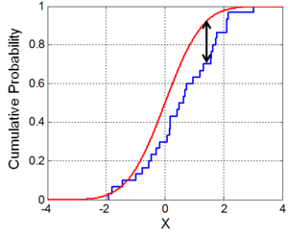
2. One sample Kolmogorov Smirnov test:-(to check whether the data come from a poisson distribution or not)
One-sample Kolmogorov-Smirnov test | One-sample Kolmogorov-Smirnov test | One-sample Kolmogorov-Smirnov test
data: y1 | data: y2 | data: y10
D = 1 | D = 1 | D = 1
p-value = 0.2703 | p-value = 0.2703 | p-value = 0.2703
One-sample Kolmogorov-Smirnov test | One-sample Kolmogorov-Smirnov test | One-sample Kolmogorov-Smirnov test
data: y11 | data: y12 | data: y13
D = 1 | D = 1 | D = 1
p-value = 0.2703 | p-value = 0.2703 | p-value = 0.2703
One-sample Kolmogorov-Smirnov test | One-sample Kolmogorov-Smirnov test
data: y14 | data: y15
D = 1 | D = 1
p-value = 0.2703 | p-value = 0.2703
FROM THE OUTPUT WE CAN SEE THAT THE TEST STATISTIC IS 1 AND THE CORRESPONDING p-VALUE IS 0.2703.SINCE THE p-VALUE IS GREATER THAN 0.05 WE ACCEPT THE NULL HYPOTHESIS.WE HAVE SUFFICIENT EVIDENCE TO SAY THAT THE SAMPLE DATA DOES NOT COME FROM A POISSON DISTRIBUTION.

Slide 19
3.TWO sample Kolmogorov Smirnov test:-(to check whether the TWO dataSET come from a SAME distribution or not)
Two -sample Kolmogorov-Smirnov test | Two -sample Kolmogorov-Smirnov test | Two -sample Kolmogorov-Smirnov test
data: y1 and y2 | data: y1 and y10 | data: y1 and y11
D = 0.20267 | D = 0.48942 | D = 0.71548
p-value < 2.2e-16 | p-value < 2.2e-16 | p-value < 2.2e-16
Two-sample Kolmogorov-Smirnov test | Two-sample Kolmogorov-Smirnov test | Two -sample Kolmogorov-Smirnov test
data: : y1 and y12 | data: y1 and y13 | data: y1 and y14
D = 0.65033 | D = 0.41258 | D = 0.41258
p-value < 2.2e-16 | p-value < 2.2e-16 | p-value < 2.2e-16
Two -sample Kolmogorov-Smirnov test | Two -sample Kolmogorov-Smirnov test
data: y2 and y14 | data: y2 and y15
D = 0.63474 | D = 0.47049
p-value < 2.2e-16 | p-value < 2.2e-16
Two -sample Kolmogorov-Smirnov test | Two -sample Kolmogorov-Smirnov test | Two -sample Kolmogorov-Smirnov test
data: y2 and y11 | data: y2 and y12 | data: y2 and y13
D = 0.71548 | D = 0.65033 | D = 0.41258
p-value < 2.2e-16 | p-value < 2.2e-16 | p-value < 2.2e-16
Two -sample Kolmogorov-Smirnov test | Two -sample Kolmogorov-Smirnov test | Two -sample Kolmogorov-Smirnov test
data: y1 and y15 | data: y3 and y4 | data: y2 and y10
D = 0.47049 | D = 1 | D = 0.48942
p-value < 2.2e-16 | p-value < 2.2e-16 | p-value < 2.2e-16
FROM THE OUTPUT WE CAN SEE THAT THE TEST STATISTIC IS DIFFERENT FOR DIFFERENT PAIRS AND THE CORRESPONDING p-VALUE IS 2.2e-16.SINCE THE p-VALUE IS LESS THAN 0.05 WE REJECT THE NULL HYPOTHESIS.WE HAVE SUFFICIENT EVIDENCE TO SAY THAT THE SAMPLE DATASETS DO NOT COME FROM THE SAME DISTRIBUTION.

Slide 20
4. .WILCOXON SIGNED RANK TEST:-(NON PARAMETRIC VERSION OF PAIRED T-TEST)
Wilcoxon rank sum test | Wilcoxon rank sum test | Wilcoxon rank sum test
data: y10 and y15 | data: y13 and y10 | data: y13 and y15
W = 1609500 | W = 1670477 | W = 1682985
p-value = 0.9152 | p-value = 0.06334 | , p-value = 0.02381
1.AS HERE IN THE 1ST AND 2ND CASE THE P-VALUE IS GREATER THAN 0.05 WE FAIL TO REJECT THE NULL HYPOTHESIS.THERE IS NO STATISTICALLY SIGNIFICANT DIFFERENCE.
2.AS HERE THE P-VALUE IS LESS THAN 0.05 WE REJECT THE NULL HYPOTHESIS.THERE IS STATISTICALLY SIGNIFICANT DIFFERENCE.
5.KRUSKAL-WALLIS TEST:-(COMPARING TWO MEANS)
Kruskal-Wallis rank sum test | Kruskal-Wallis rank sum test | Kruskal-Wallis rank sum test
data: y1 by y2 | data: y1 by y4 | data: y1 by y5
Kruskal-Wallis chi-squared = 1105.7, df = 21 | Kruskal-Wallis chi-squared = 30.464, df = 41 | Kruskal-Wallis chi-squared = 57.263, df = 43
p-value < 2.2e-16 | p-value = 0.8861 | , p-value = 0.07147
1.HERE IN THE 1ST CASE THE P-VALUE IS LESS THAN 0.05,SO WE REJECT THE NULL HYPOTHESIS.THE MEANS ARE SIGNIFICANTLY DIFFERENT.
2.HERE IN THE 2ND AND 3RD THE P-VALUE IS GREATER THAN 0.05,SO WE ACCEPT THE NULL HYPOTHESIS.THE MEANS ARE NOT SIGNIFICANTLY DIFFERENT.

Slide 21
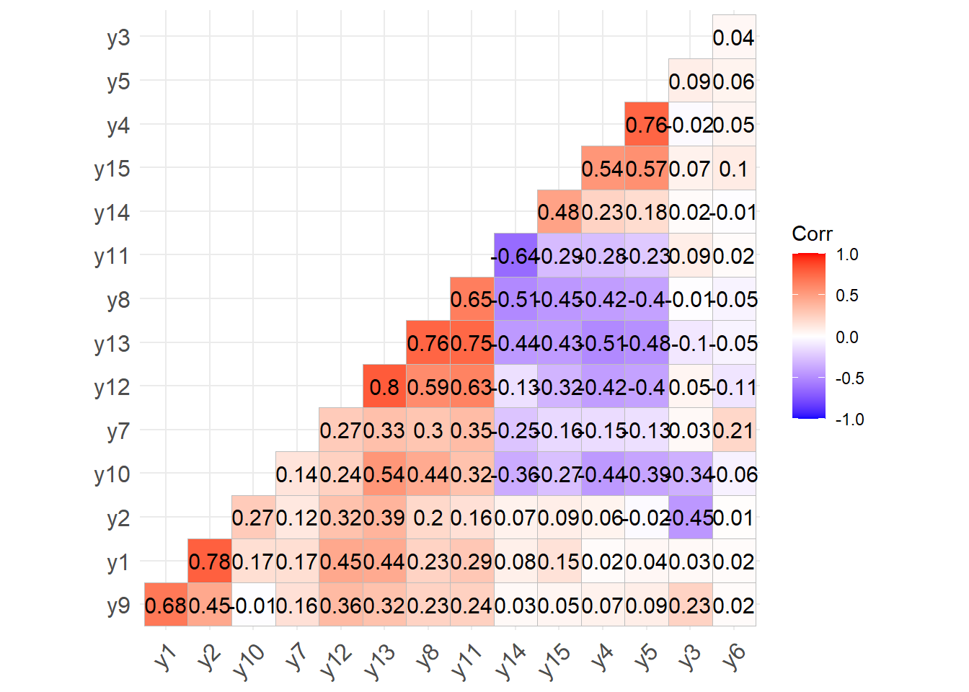
CORRELATION PLOT:

Slide 22
CORRELATION TEST
VARIABLE 1 | VARIABLE 2 | P-VALUE | CORRELATION | VARIABLE 1 | VARIABLE 2 | P-VALUE | CORRELATION
y1 | y2 | < 2.2e-16 | 0.78 | y2 | y3 | < 2.2e-16 | -0.45
y1 | y12 | < 2.2e-16 | 0.45 | y11 | y12 | < 2.2e-16 | 0.63
y13 | y12 | < 2.2e-16 | 0.8 | y1 | y4 | = 0.3175 | 0.02
y13 | y8 | < 2.2e-16 | 0.76 | y1 | y5 | = 0.1087 | 0.04
y13 | y11 | < 2.2e-16 | 0.75 | y2 | y13 | < 2.2e-16 | 0.39
HERE WE CAN SEE THAT THE VARIABLE y13 HAS A HIGH POSITIVE CORRELATION VALUE WITH THE VARIABLES y8,y11,y12. HERE WE CAN SEE THAT THE VARIABLE y1 HAS A HIGH POSITIVE CORRELATION VALUE WITH THE VARIABLE y2. HERE WE CAN SEE THAT THE VARIABLE y1 HAS A MODERATE POSITIVE CORRELATION VALUE WITH THE VARIABLE y12. HERE WE CAN SEE THAT THE VARIABLE y2 HAS A MODERATE POSITIVE CORRELATION VALUE WITH THE VARIABLE y13.AND WE CAN SEE THAT THE p-VALUE IS LOWER THANN0.05. HERE WE CAN SEE THAT THE VARIABLE y1 HAS A MODERATE NEGATIVE CORRELATION VALUE WITH THE VARIABLE y3. HERE WE CAN SEE THAT THE VARIABLE y1 HAS NO CORRELATION WITH THE VARIABLES y4,y5. AND WE CAN SEE THAT THE p-VALUE IS GREATER THAN 0.05.

Slide 23
TWO SAMPLE t-TEST
VARIABLE 1 | VARIABLE 2 | P-VALUE | MEAN OF VARIABLE 1 | MEAN OF VARIABLE 2
y10 | y13 | = 0.0002465 | 71.34633 | 72.59633
y10 | y15 | = 0.0243 | 71.34633 | 72.10690
y13 | y15 | = 0.06607 | 72.59633 | 72.10690
[ASSUMING THAT THE DATA COMES FROM NORMAL POPULATION]
Because the p-value of our test (0.0002465) is less than alpha = 0.05, we reject the null hypothesis of the test. This means we have sufficient evidence to say that the mean rating of players between the two ratings (here pace and dribbling) is different.
Because the p-value of our test (0.0243) is less than alpha = 0.05, we reject the null hypothesis of the test. This means we have sufficient evidence to say that the mean rating of players between the two ratings (here pace and physic) is different.
Because the p-value of our test (0.06607) is greater than alpha = 0.05, we fail to reject the null hypothesis of the test. This means we have sufficient evidence to say that the mean rating of players between the two ratings (here dribbling and physic) is not different.

Slide 24
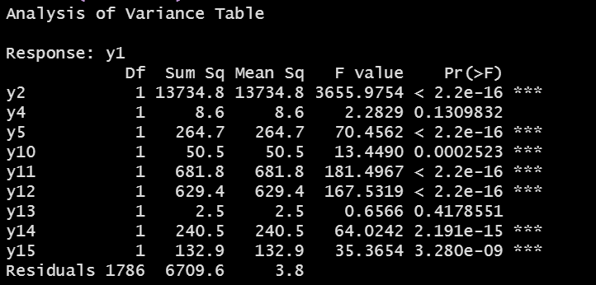
ANOVA(analysis of variance)
An ANOVA test is a way to find out if survey or experiment results are significant. In other words, they help you to figure out if you need to reject the null hypothesis or accept the alternate hypothesis. Basically, we’re testing groups to see if there’s a significant difference between them.
We want to set up the test hypothesis such that-
Null hypothesis( Ho ) : There is no effect of the amount of each factor (other ratings) used on the overall rating of the players.
Against
Alternative hypothesis( H1 ) : There is a significant effect of the amount of each factor(other ratings) used on the overall rating of the players.
From the above anova table results,we can infer that there is a significant effect of the factors Potential Rating,Weight,Pace Rating ,Shooting Rating,Passing Rating, Defending Rating ,Physic Rating on the response variable Overall Rating.Based on the above observations We reject the null hypothesis that there is no effect of the amount of each factor (other ratings) used on the overall rating of the players.

Slide 25
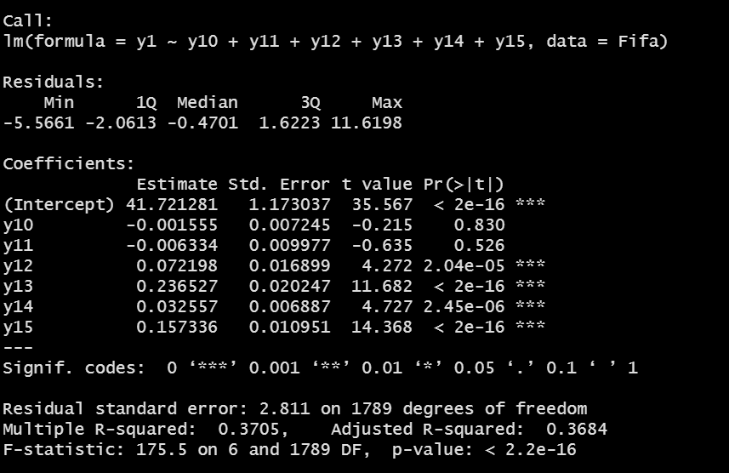
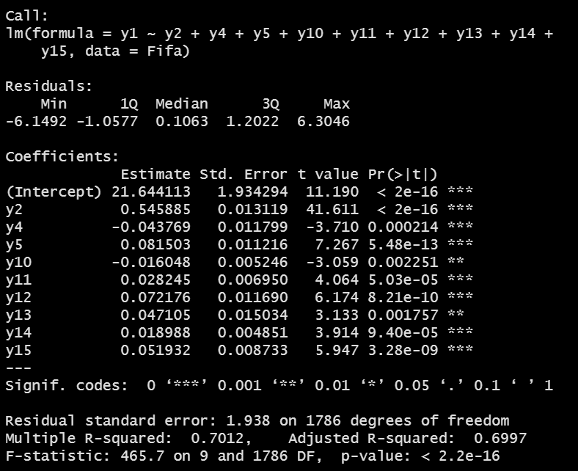
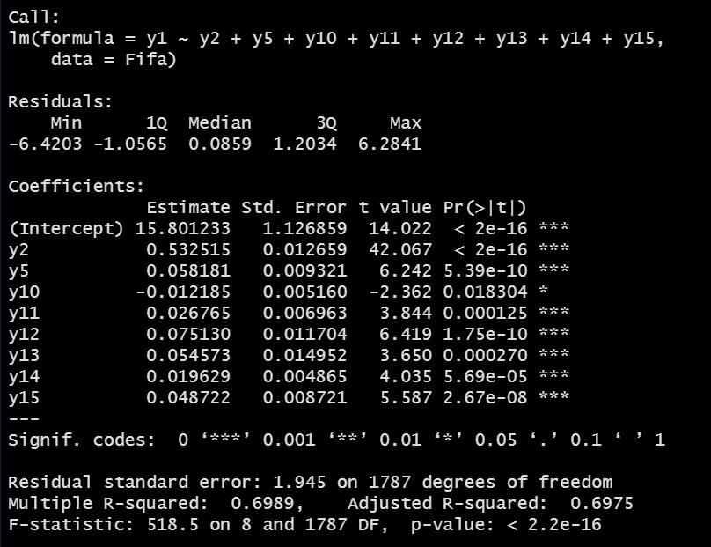
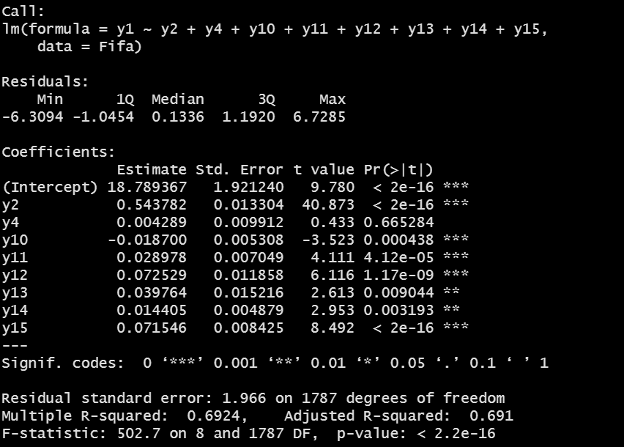

REGRESSION ANALYSIS:- (1.Multiple Linear Regression )
From the above summary we can see that that R2 value is 0.3705. This means that 37% of the variability observed in the target variable (Overall Rating) can be explained by this linear regression model. Therefore we can say that this model fitting is not good enough.
From the above summary we can see that that R2 value is 0.7012. This means that 70% of the variability observed in the target variable (Overall Rating) can be explained by this linear regression model. Therefore we can say that this model fitting is moderately good enough.
From the above summary we can see that that R2 value is 0.6989. This means that 70% of the variability observed in the target variable (Overall Rating) can be explained by this linear regression model. Therefore we can say that this model fitting is moderately good enough
From the above summary we can see that in the 1st case R2 value is 0.6924. This means that 70% of the variability observed in the target variable (Overall Rating) can be explained by this linear regression model. Therefore we can say that this model fitting is moderately good enough. In the 2nd case R2 value is 0.6923. This means that 70% of the variability observed in the target variable (Overall Rating) can be explained by this linear regression model. Therefore we can say that this model fitting is moderately good enough.
After comparing 3rd and 4th model we can say that if we change the y4(HEIGHT) variable by y5(WEIGHT) variable then the R-squared value does not change significantly .Even we can see thtat if we eliminate the y4 and y5 variables from the model the R-squared value remains constant.So we can say that y4 and y5 does not effect the value of y1 significantly.

Slide 26




2.Generalized Linear Model
We can use the Chi-Square to P-Value Calculator to find that a X² value of 73.6 with 6 degrees of freedom has a p-value less than 0.000001.Since this p-value is much less than .05, we would conclude that the model is highly useful.
Here the AIC VALUE is -2007.2
We can use the Chi-Square to P-Value Calculator to find that a X² value of 125.45 with 6 degrees of freedom has a p-value less than 0.000001.Since this p-value is much less than .05, we would conclude that the model is highly useful.
Here the AIC VALUE is -11456
We can use the Chi-Square to P-Value Calculator to find that a X² value of 108.72 with 6 degrees of freedom has a p-value less than 0.000001.Since this p-value is much less than .05, we would conclude that the model is highly useful.
Here the AIC VALUE is - 11290
We can use the Chi-Square to P-Value Calculator to find that a X² value of 41.76 with 6 degrees of freedom has a p-value less than 0.000001.Since this p-value is much less than .05, we would conclude that the model is highly useful.
Here the AIC VALUE is -5730.4

Slide 27






X² value of 25.98 with 2 degrees of freedom has a p-value less than 0.000001.Since this p-value is much less than .05, we would conclude that the model is highly useful.
Here the AIC VALUE is -11364
X² value of 61.33 with degrees of freedom 3 has a p-value less than 0.000001.Since this p-value is much less than .05, we would conclude that the model is highly useful.
Here the AIC VALUE is - 11331
X² value of 66.56 with 4 degrees of freedom has a p-value less than 0.000001.Since this p-value is much less than .05, we would conclude that the model is highly useful.
Here the AIC VALUE is - 11328
X² value of 87.48 with 8 degrees of freedom has a p-value less than 0.000001.Since this p-value is much less than .05, we would conclude that the model is highly useful.
Here the AIC VALUE is - 11309
X² value of 175.41 with 8 degrees of freedom has a p-value less than 0.000001.Since this p-value is much less than .05, we would conclude that the model is highly useful.
Here the AIC VALUE is - 11227
X² value of 176.51 with 8 degrees of freedom has a p-value less than 0.000001.Since this p-value is much less than .05, we would conclude that the model is highly useful.
Here the AIC VALUE is - 11226

Slide 28
conclusion
FROM THE ANALYSIS WE CAN SEE THAT THERE HAS SOME ASSOCIATION BETWEEN VARIOUS RATING SYSTEM AND THERE HAS NO ASSOCIATION BETWEEN VARIOUS RATING SYSTEM .
WE CAN SAY THAT THE DATA DOES NOT COME FROM NORMAL DISTRIBUTION .
ACTUALLY WE CAN SAY THAT THE DATA COMES FROM POISSON DISTRIBUTION.
WE CAN SAY THAT ANY TWO DATASET(i.e THE RATINGS) DOES NOT COME FROM A SAME DISTRIBUTION.
From ANOVA we can infer that there is a significant effect of the factors Potential Rating,Weight,Pace Rating ,Shooting Rating,Passing Rating, Defending Rating ,Physic Rating on the response variable Overall Rating.Based on the above observations We reject the null hypothesis that there is no effect of the amount of each factor (other ratings) used on the overall rating of the players.
We can say that the Generalized Linear Model is more useful than MULTIPLE LINEAR REGRESSION MODEL in that dataset as WE CAN CLEARLY SEE THAT THE DATASET COMES FROM A POPULATION WHICH FOLLOWS POISSON DISTRIBUTION NOT FROM A POPUKLATION WHICH FOLLOWS NORMAL DISTRIBUTION .

Slide 29
REFERENCE:
The information used in project have been collected from the sources given below:
http://www.stat.yale.edu/Courses/1997-98/101/linmult.htm
http://www.stat.yale.edu/Courses/1997-98/101/anovareg.htm
Introduction to Linear Regression Analysis Book by Douglas Montgomery, Elizabeth A. Peck, and G. Geoffrey Vining
https://statsandr.com/blog/multiple-linear-regression-made-simple/
https://rc2e.com/linearregressionandanova
https://www.statology.org/interpret-regression-output-in-r/
https://www.statology.org/interpret-glm-output-in-r/
https://www.statology.org/
Fundamentals of Statistics (Vol - 1) – A. M. Gun, M. K. Gupta, B. Dasgupta
Fundamentals of Statistics (Vol – 2) – A. M. Gun, M. K. Gupta, B. Dasgupta
An Outlines of Statistical Theory (Vol - 2) – A. M. Gun, M. K. Gupta, B. Dasgupta
Fundamentals of Applied Statistics – S. C. Gupta, V. K. Kapoor
Google
Wikipedia

Slide 30
Thank You

